Slide 1
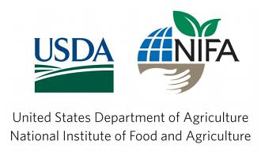
This presentation is part of an educational modular program designed to provide new and beginning farmers and ranchers with relevant information to initiate, improve and run their agricultural operations
This program is funded by the
Beginning Farmer and Rancher Development Program (BFRDP)
USDA-NIFA-BFRDP 2010-03143

Slide 2
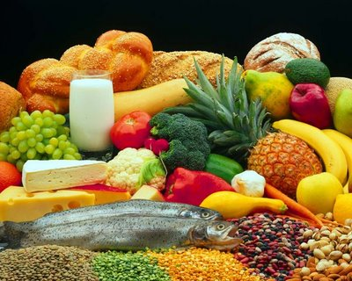
Legal Issues in Food Safety

Slide 3
Disclaimer
This presentation is intended to provide general information about food safety laws and should not be construed as providing legal advice. It should not be cited or relied upon as legal authority. State laws vary and any attempt made to discuss laws of states other than Arkansas is for general information to help the viewer better understand Arkansas law
For advice about how these issues might apply to your individual situation, consult an attorney

Slide 4
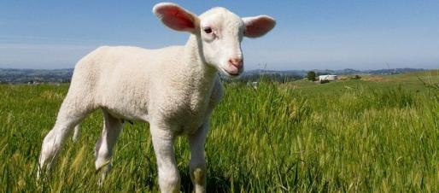
Objectives
Provide a review of food safety rules and regulations that could impact a producer in fruit, vegetable or livestock operations
Provide an overview of Arkansas state law requirements for the keeping of livestock on your property:
Animal welfare laws
Control of animal diseases
Disposal of dead animals

Slide 5
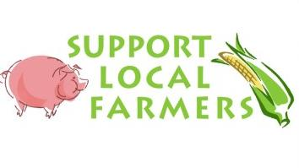
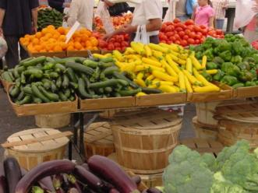
Overview
Direct sales of agricultural commodities to consumers is a growing market segment
From 1997 to 2007, direct sales grew by 105%
That is compared to a 48% increase for all agricultural sales
Consumers are demanding more locally grown products and many new producers are entering agriculture to meet this growing demand

Slide 6
Overview
A producer considering entering into the direct sales market will need to consider the impact on their business
Direct sales will bring in to consideration:
Food safety issues
Food safety inspections and monitoring
This presentation will provide an overview of the legal and regulatory issues that could be presented in a direct sales farm business

Slide 7
Insurance
Insurance should be one of the first expenses new producers consider
The producer will want to discuss with their insurance agent the true nature of the producer’s operation
For example, a producer would want to let their insurance agent know if they plan to provide custom slaughtering and processing. This will allow the producer to have the proper level of insurance coverage
The producer should view insurance as one risk management tool that could prevent larger costs down the road
ALWAYS GET INSURANCE!!

Slide 8
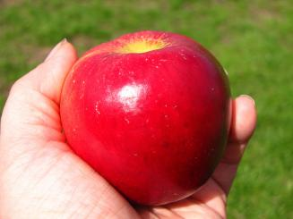
Fruits and Vegetables
Fruit and vegetable regulations depend on whether they are:
Processed – Changing the food from its original state; or
For example, dried apple slices would be processed
Unprocessed – The food in its natural state.
For example, a whole apple would be unprocessed

Slide 9
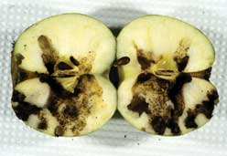
Unprocessed Fruits and Vegetables (UFVs)
Generally, unprocessed fruits and vegetables (UFVs) are not regulated by the Arkansas Health Department (ADH)
UFVs are only regulated when they are adulterated, meaning diseased, contaminated, filthy, putrid or decomposed substance, or if it is otherwise unfit for food
Ark. Code § 20-56-208(1)
Good business practice – Only sell customers clean and fresh UFVs.

Slide 10
Processed Fruits and Vegetables
Processed fruits and vegetables (PFVs) are regulated by ADH for consumer safety
ADH uses the FDA’s Food Code to establish safe standards and procedures to ensure safety in the processing and final processed product
PFVs will need to have some form of labeling on the products that bears:
The common name of the food, such as “Salad Mix”
Ark. Code § 20-56-209
Labels should also include all ingredients.

Slide 11
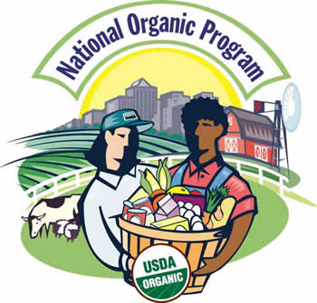
National Organic Program
A producer may consider growing organic fruits, vegetables, or livestock
In order to market your products as “organic” you must follow the National Organic Program (NOP) standards
NOP is a program run through the USDA’s Agricultural Marketing Service (AMS) to provided a uniform framework of standards for the production and marketing of organic products

Slide 12
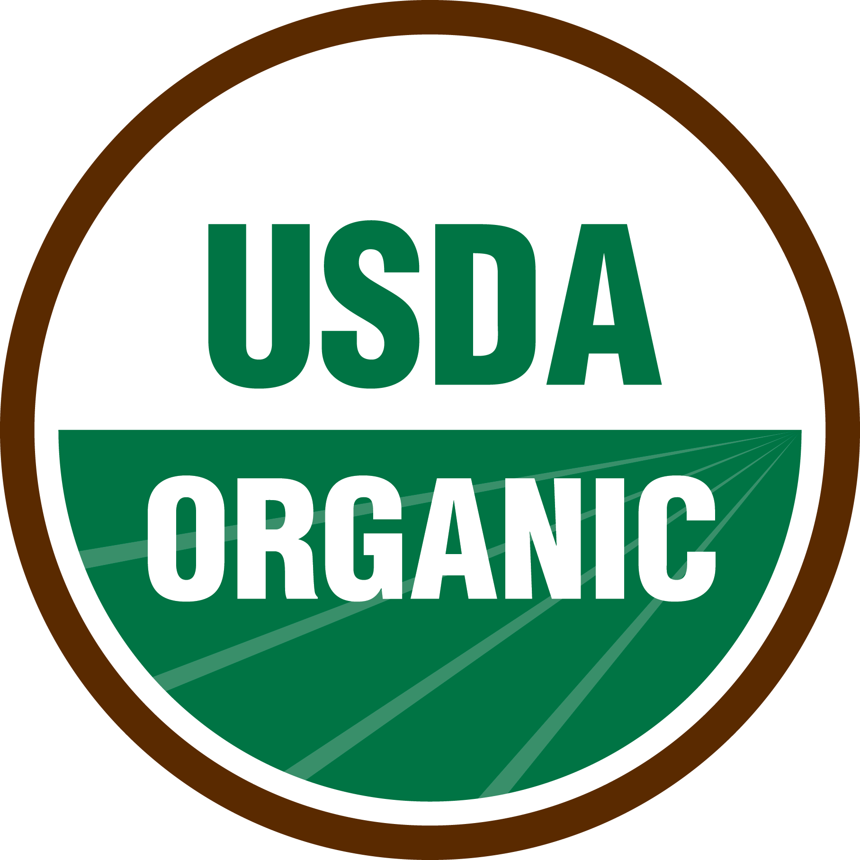
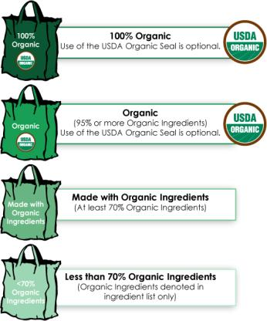
Certified Organic
Individuals or companies who misuse the USDA Organic Seal or mislabel a product as “Organic” can get into costly trouble
If a product carries the USDA Organic Seal or if a food product states “Organic” somewhere in the packaging, the product MUST be certified organic
If the product is not certified organic, individuals or businesses may be fined up to $11,000 per violation

Slide 13
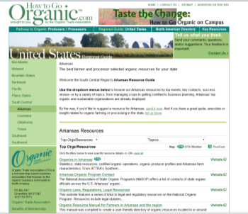
National Organic Program
NOP requires any producer selling more than $5,000 worth of organic products annually to become certified by a USDA-accredited certifying agent
Certification can be an expensive process depending on the size and location of the farm
Arkansas currently has no certifying agents, but the Arkansas Agricultural Department does provide cost-share to defer some of the certification costs
The website “How to go Organic.com” (http://www.howtogoorganic.com), run by the Organic Trade Association, has a list of contacts in each state and a list of resources for farmers in Arkansas and the region interested in organic agricultural production

Slide 14
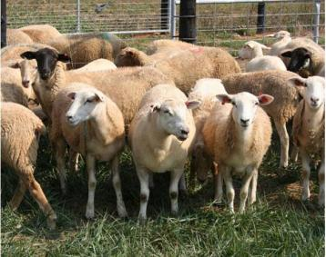
Livestock & Poultry
If a producer is raising livestock or poultry, make sure the following laws are followed when applicable:
Arkansas’s Animal Welfare law
Arkansas’s Branding laws
Regulations on the movement of livestock
Arkansas’s dead animal disposal laws

Slide 15
Animal Welfare Laws
Ark. Code § 5-62-103 makes cruelty to animals a crime
Cruelty to animals is defined as cruelly treating an animal by:
Failing to provide adequate food, water, and shelter;
Abandons the animal without providing for the animal’s continued sustenance;
Transports the animal in an inhumane manner
Ark. Code § 5-62-105(a)(5) provides for an exemption to the animal cruelty statute when the person is using “generally accepted animal husbandry practices”
Accepted animal husbandry practices include breeding, raising, production, management of animals, dehorning, docking, and castration - Ark. Code § 5-62-102(4)(A)-(B)

Slide 16
Animal Welfare Laws
A livestock owner will not be able to knowingly allow their livestock to run free
Ark. Code § 5-62-122
Livestock are horses, mules, bovine animals, goats, sheep, swine, chickens, ducks, or similar animals used for farm purposes
Ark. Code § 5-62-102(15)
Generally this statute has been interpreted to mean that the livestock owner failed to exercise reasonable care in keeping his/her livestock from running free
To show reasonable care, a producer would want to do their best to keep fences up and immediately capture loose livestock

Slide 17
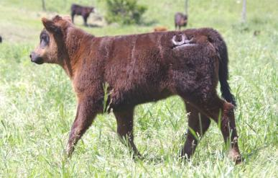
Animal Branding
All cattle, goats, sheep, and hogs over 6 months of age in Arkansas are required to have either an earmark or a brand
Ark. Code § 2-34-101
Earmarking is a distinctive cut or mark in the ear used to show ownership of the livestock
A brand is letters, numbers, or figures burned or frozen on a certain location of a live animal with a hot iron or frozen chemicals. It is applied on the right hip
Ark. Code § 2-34-201

Slide 18
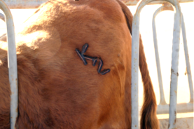
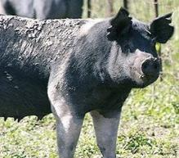
Animal Branding
Brands shall be registered with the Arkansas Livestock and Poultry Commission.
Costs $5 to register
Brand will have to be reregistered every 5 years
Ark. Code § 2-34-208
Earmarks will need to be recorded with the clerk of the county court where the livestock is located.
Ark. Code § 2-34-101

Slide 19
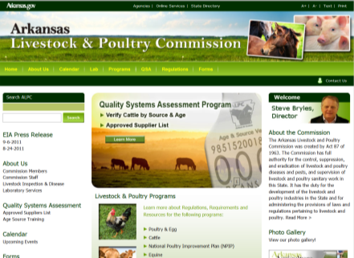
Control of Animal Diseases
All animals brought into Arkansas from out-of-state need certifications proving they have been disease free for 30 to 90 days
Check with the Arkansas Livestock and Poultry Commission (ALPC) before transporting any new livestock or poultry into Arkansas to determine the specific rules for each type of animal wished to be transported into Arkansas

Slide 20
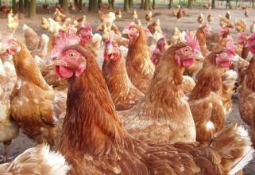
Control of Animal Diseases
Livestock and poultry exposed to certain diseases can be subject to quarantine or destruction
When funds are available, ALPC is required to compensate livestock and poultry owners for any destruction or disinfection from disease of animals and equipment
Ark. Code § 2-40-103
Before any poultry flock is destroyed, ALPC must first attempt to negotiate a fair market price for the flock with the owners and if the negotiations fail then ALPC can condemn the flock and compensate the owners after the flock has been destroyed.

Slide 21
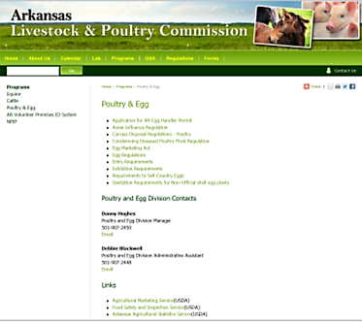
Control of Animal Diseases
When dealing with an animal health issue, always check the ALPC’s website to get the latest and up-to-date regulations involving various livestock and poultry diseases
When in doubt about an animal disease outbreak in your livestock or poultry, contact the ALPC to determine what steps you should take to be incompliance with state law
For example, you can obtain information about permits, regulations and requirements for poultry and egg products in Arkansas and obtain contact information in your area

Slide 22
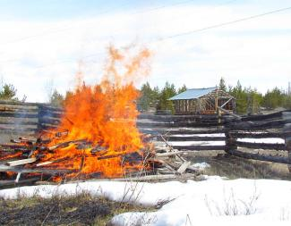
Dead Animal Disposal
Large livestock carcasses can be disposed of by:
Rendering
Burial
Extrusion
Cooking the carcass for swine food
Composting
Incineration
Buried by special order of the state vet
Ark. Code R. § 125.00.13

Slide 23
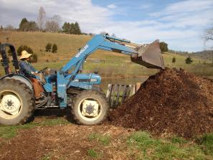
Dead Animal Disposal
Poultry carcasses can be disposed of the following ways in Arkansas:
Cremation or incineration
Composting
Extrusion
Rendering
Cooking for swine feed
On-farm freezing
Ark. Code R. § 125.00.7

Slide 24
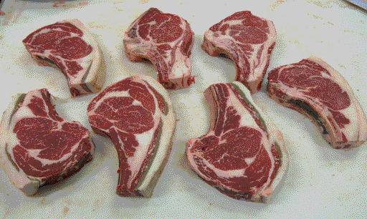
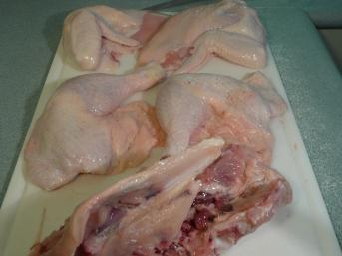
Slaughter and Processing

Slide 25
Slaughter & Processing Issues Overview
Each of these issues will be explored in the following slides:
Application of the Humane Slaughter Act
Inspections required for the slaughter process
Exemptions to the required inspections
Labeling requirements
Requirements for specialty meat and poultry products

Slide 26
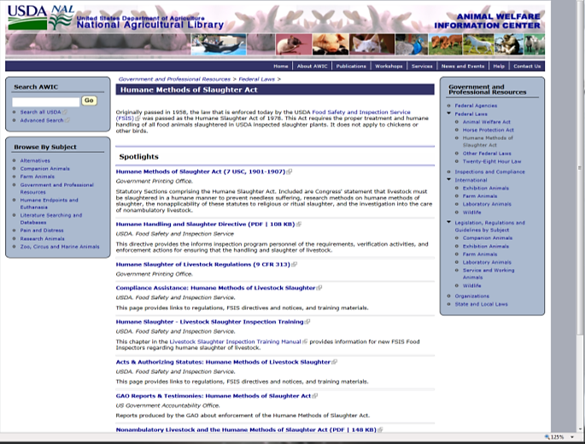
Visit the USDA- Animal Welfare Information Center for specific information on the different animal species http://awic.nal.usda.gov/government-and-professional-resources/federal-laws/humane-methods-slaughter-act

Slide 27
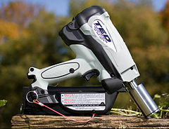
Humane Slaughter Act
The Humane Slaughter Act, 7 U.S.C § 1902, is a federal law that requires all animals to be stunned unconscious before they are slaughtered
The Act applies to the slaughter of sheep, goats, pigs, and cattle.
Poultry are specifically excluded from the Act
Typical stunning methods are:
For hogs, electrocution or CO2 gas
For cattle, sheep, and goats, captive bolt gun
Captive bolt gun

Slide 28
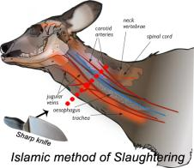
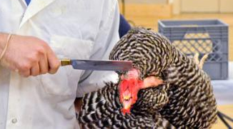
Humane Slaughter Act
The Act also excludes any animal slaughtered in accordance with religious law
For Judaism, this would allow for kosher meat products.
For Islam, this would allow for Halal meat products
The animal’s slaughter must be done in accordance with each religion’s law in order to meet the exception
Humane slaughter practices are required in all slaughter facilities inspected by USDA

Slide 29
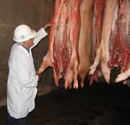
Federal and State Inspections
Slaughter and processing facilities must comply with federal and state inspections and licensing requirements
For federal inspections and licenses, USDA’s Food Safety and Inspection Service (FSIS) oversees these inspections and licenses
For state inspections and licenses, the Arkansas Department of Health (ADH) would oversee the state inspections & licenses
Currently in Arkansas, no plant is state-only inspected, but a mixture of federal and state inspection
In Arkansas, FSIS has subcontracted all federal inspection duties to ADH

Slide 30
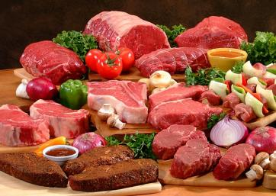
Federal and State Inspections
Not all meat is considered “meat” under federal regulations
“Meat” includes beef, pork, sheep, and goat
Poultry is considered separate from regulations dealing with the slaughter and processing of “meat”
Meat and poultry inspection regulations will be examine separately in the following slides

Slide 31
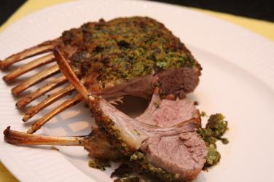
Meat Inspections
Because FSIS has subcontracted to ADH for federal inspections, all facilities are certified and inspected according to federal standards
Use the Federal Meat Inspection Act, 21 U.S.C. §§ 601-695, and accompanying regulations at 9 C.F.R. Parts 300-599
If the producer is going to slaughter and process their own pigs, cattle, sheep, or goats, the facility must meet the federal standards
The facility will have to be approved for each type of animal the producer wants to slaughter
For example, if the producer wants to slaughter goats and sheep, the facility will have to be approved for both goats and sheep
Lamb chops

Slide 32
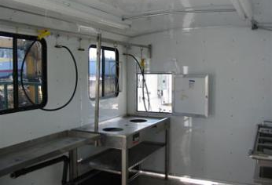
Meat Inspections
Federal standards for facilities:
Facilities for different functions need to be kept separate to prevent contamination
For example, the facilities to hold live animals should be separate from slaughter facilities and butchering facilities should be kept separate from slaughter facilities
Facilities need to be well lit
Equipment and facilities need to be easy to wash and disinfect
All equipment must be appropriate to be used on the animal being slaughtered and butchered

Slide 33
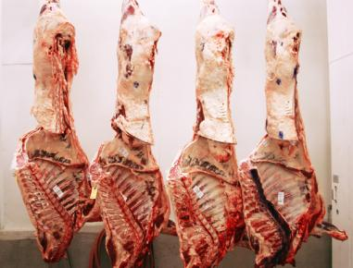
Meat Inspection
FSIS will inspect all animals in the slaughterhouse before slaughter and after slaughter to insure the animals and the carcasses are healthy and sound
USDA’s Ag Marketing Service (AMS) will grade the carcasses upon the request of the processor
AMS charges to grade the carcasses
FSIS does not charge for the mandatory inspection process.
The carcass grading varies between livestock types and are typically graded on the quality of the carcass

Slide 34
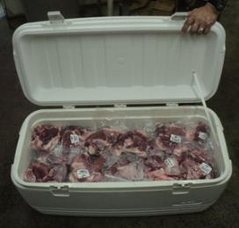
Meat Inspections
Each facility is required to develop a “Sanitary Standard Operating Procedures” (SSOP) plan and “Hazard Analysis and Critical Control Point” (HACCP) plan
SSOP – A written plan developed by the facility and implemented to prevent direct contamination and adulteration of the product through the various slaughtering and butchering processes
This plan should stay on file with the facility
If FSIS find the SSOP plan to be lacking, then the facility must take corrective actions to maintain compliance

Slide 35
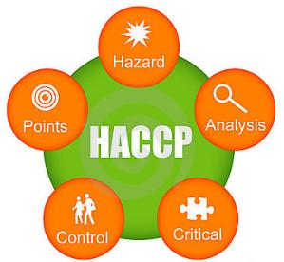
Meat Inspection
HACCP plans are systematic approaches to food safety that address the hazards in the slaughter and butchering processes and look for preventive methods to avoid those hazards from occurring
For example, one area of a HACCP plan would be the disinfecting and cleaning of surfaces and equipment to prevent E. coli contamination
Each facility will need its own HACCP plan on file at the facility
A producer looking at processing their own meat products to sell to consumers may want to consider looking at HACCP and SSOP workshops organized by Dr. John Marcy with the Poultry Science Department at the University of Arkansas for a better understanding for how to develop these plans

Slide 36
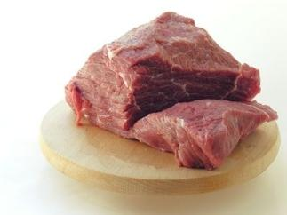
Exception to Meat Inspection
Sell the live animal to customer for custom slaughter and processing
Federal rules for inspection do not apply to facilities that process a third party’s animal for the third party’s personal consumption
The plant must still have SSOP and HACCP plans and be inspected periodically
The producer can simply sell the animal to the consumer over the phone then ship to the processor or let the consumer pick out their animal for processing

Slide 37
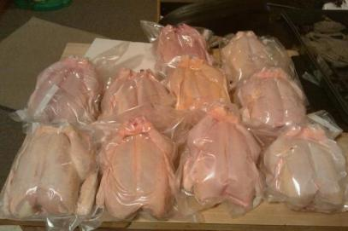
Poultry Inspection
Poultry inspection is governed by the Federal Poultry and Poultry Products Inspection Act (21 U.S.C. §§ 451-471)
This Act requires all poultry slaughtering and processing facilities to be inspected
Poultry slaughtering and processing facilities will also be required to have a SSOP and a HACCP plan.

Slide 38
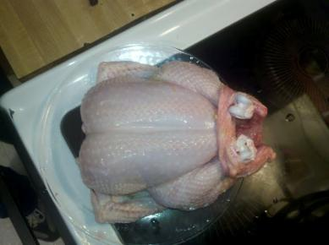
Poultry Inspection
In Arkansas, FSIS conducts all poultry inspections and not ADH
The Poultry Inspection Act allows states to set up their own inspection programs but at this time Arkansas has not implemented a program
Unlike with Federal Meat Inspection Act, the Poultry Inspection Act provides more than one exception to mandatory inspections.

Slide 39
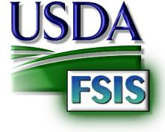
Poultry Inspection Exemptions
Exemptions to the Poultry Inspection Act:
Poultry producer’s own use
Custom slaughter/processing
1,000 poultry limit
20,000 poultry limit
Poultry Producer/Grower or Other Person
Small Enterprise Exemption
Retail Exemption
FSIS provides guidance to help growers understand if they met any of the Exemptions. See http://www.fsis.usda.gov/oppde/
rdad/fsisnotices/poultry_slaughter_exemption_0406.pdf

Slide 40
Poultry Inspection Exemptions
The typical exemptions that a poultry producer will fall under are:
Poultry producer’s own use
Custom slaughter/processing
1,000 poultry limit; and
20,000 poultry limit
The other three exemptions are less likely to be used by a poultry producer and will not be discussed in these slides, but these three exemptions are explained in the FSIS Guidance

Slide 41
Producer’s Own Use
This exemption occurs when the farmer, owner, or grower of the poultry, slaughters and processes the poultry for their own personal use
Poultry slaughtered and processed under this exemption must be:
For the private use of the owner/grower of the poultry, the owner/grower’s family, nonpaying guests, or employees
Animals are healthy for slaughter
Processed under sanitary conditions
Not be donated or sold for use as human food

Slide 42
Custom Slaughter/Processing
With this exemption, a processor is providing a service to the owner/grower of poultry – includes a mobile slaughtering unit
To qualify for this exemption, the custom slaughter/ processing facility:
Can sell live poultry
Can not be engaged in selling poultry products, meaning any poultry carcass or part of the carcass, capable of human consumption
That is , that the processor could sell a live bird to a buyer then slaughter the bird and fall under this exception
Poultry is healthy when slaughtered
Slaughtered and processed in sanitary conditions

Slide 43
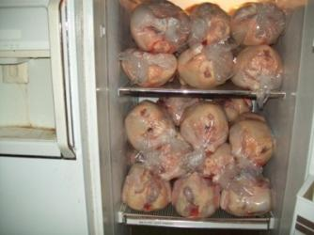
1,000 Limit For Producer/Grower
A producer/grower can slaughter no more than 1,000 poultry per calendar year and be exempt from federal inspection requirements
To qualify for this exception the producer/owner must:
Only slaughter/process no more than 1,000 healthy birds that the producer/owner
The grower can only buy and sell those poultry products produced from the grower’s poultry
Slaughter and processing are done in clean and sanitary conditions
Producer/grower keeps all necessary records to help FSIS enforce the exception
The poultry can only be sold in-state and not across state lines

Slide 44
20,000 Limit For Producer/Grower
To qualify for this exemption the producer/grower must:
1 | Slaughter/process no more than 20,000 poultry in a calendar year raised by the grower/producer
2 | Sell only poultry products from the 20,000 poultry and not buy or sell poultry produced under another exception in the same calendar year
3 | Poultry products produced are solely distributed in the state where produced
4 | Poultry was healthy at slaughter and slaughtered and processed in sanitary conditions
5 | Producer/grower only distributes poultry products produced under this exception. For example, a producer could not provide custom slaughter/processing and also claim this exception
6 | Slaughter facility is not used to process poultry for another person
7 | A producer/grower using the 20,000 poultry limit exemption may sell to: Household consumers Hotels Retail Stores (such as grocery stores or supermarkets) Restaurants and other similar institutions

Slide 45
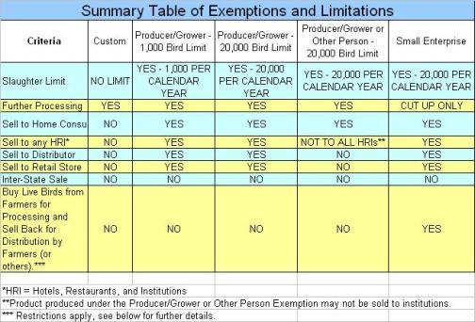
Poultry Inspection Exemptions
Each of the 4 exemptions discussed will require that the shipping containers used to distribute the poultry products in-state to bear the following label:
Poultry producer’s name;
Poultry producer’s address; and
The statement “Exempt P.L. 90-492”
P.L. 90-492 means the Poultry Inspection Act
Safe Handling Instructions.
Fitzgerald et al, 2011

Slide 46
Safe Handling Instructions Example

Slide 47
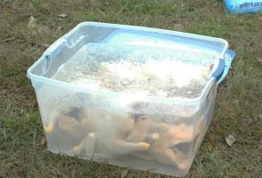
Limitations to the Exemption
A poultry producer may only claim one exemption to operate under
A poultry producer may use any exemption they qualify for
But, the poultry producer can not operate under more than one exemption simultaneously
Pick the exemption that will work best for your business and meet all of your business needs
FSIS will check to make sure you qualify for the exemption you claim

Slide 48
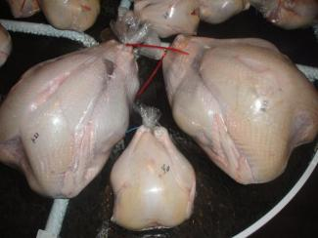
Limitations to the Exemption
Qualifying for and using an exemption only exempts the poultry producer from requiring the presence of FSIS inspectors during the slaughter and processing of poultry products
You will still need to have HACCP and SSOP plans for the facilities
Poultry producers will need to insure:
All poultry is healthy when slaughtered
Slaughter, processing, transportation are done in sanitary and healthy ways to ensure the poultry products are fit for human food
Need to be labeled so consumer knows the poultry product is exempt from FSIS inspection

Slide 49
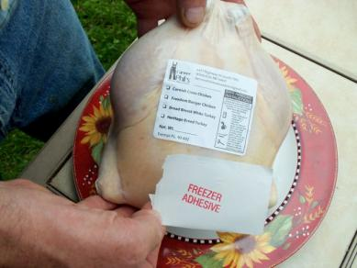
Labeling
FSIS is the agency in charge of regulating labeling in meat and poultry
Labeling means “all labels and other written, printed or graphic matter (1) upon any article or any of its containers or wrappers, or (2) accompanying such article.” 21 U.S.C. § 601(p) or 21 U.S.C. § 453(s)
This broad definition gives FSIS the authority to regulate not only the label on the meat or poultry product but any accompanying materials.

Slide 50
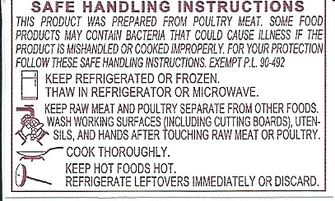
Labeling
9 C.F.R. 317.2/381 Subpart N requires that a label include 8 features:
Product name
Inspection legend and establishment number
Handling statement
Net Weight Statement
Ingredients Statement
Address Line
Nutrition facts
Safe handling instructions

Slide 51
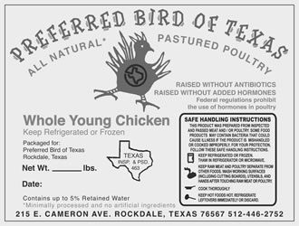
Labeling
FSIS requires all labels to be approved before they are used
A producer can simply submit a sketch of the label to FSIS; or
Use a preapproved generic label that has no special claims such as quality, health claims or negative claims. This is one way to side step the preapproval process
FSIS provides labeling guidance and changes to any regulations involving meat and poultry labeling on its website. A producer should not be afraid to check out FSIS’s website for accurate and up-to-date information
Label provides all the correct information, but includes a claim that states that the birds are raised without hormones. This is not allowed
Name, address and phone number

Slide 52
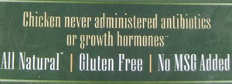
Labeling Claims
If the producer does decide to make certain claims about their products, they could use a claim such as free range, organic or antibiotic free depending with their specific production system
FSIS provides current information on each claim on their website and the website should be consulted to avoid making illegal or incorrect claims on the label

Slide 53
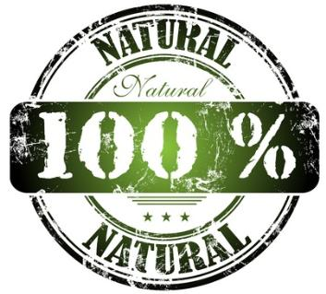
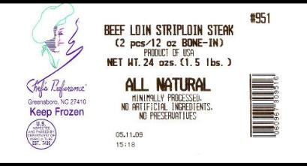
Labeling Claims
Natural
It means “[a] product containing no artificial ingredient or added color and is only minimally processed. Minimal processing means that the product was processed in a manner that does not fundamentally alter the product. The label must include a statement explaining the meaning of the term natural (such as "no artificial ingredients; minimally processed")”

Slide 54
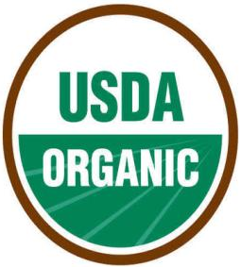
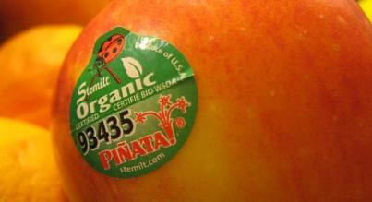
Labeling Claims
Organic
It means a product grown in accordance with NOP standards.
NOP the federal framework to regulate the growing of organic commodities by a uniform group of standards.

Slide 55
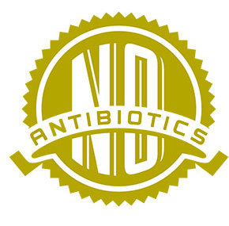
Antibiotic Free Label
Antibiotic Free
Need sufficient documentation to show that the animals were raised without the use of antibiotics.

Slide 56
Labeling Claims
Hormone Free
It is used mainly with marketing of beef that no hormones were used in the raising of the cattle
No hormones are allowed or used in poultry production and thus this claim is not approved

Slide 57
Labeling
Grass Fed
It means the animal has had access to grass, forbs, or cereal or grain crops in their pre-grain state. The animal can not be fed grains or a grain byproduct at any point during its life
Free Range
It means the poultry has had access to the outdoors and producer has records to prove this

Slide 58
Labeling Claims
Fresh
It means that the product has never had an internal temperature of less than 20ºF

Slide 59
Religious Labeling Claims
Certain religions require animals to be slaughtered in appropriate ways for that religions dietary laws
For example, the meat should be slaughtered according to Kosher standards in order to be suitable for Jewish dietary laws
Religious labeling claims include:
Kosher to qualify for Jewish dietary law
Halal to qualify for Islamic laws

Slide 60
Religious Labeling Claims
FSIS does not certify that meat or poultry products were prepared in accordance with certain religious law
FSIS only accepts the statements of the religious official doing the slaughtering that religious laws were complied with
Kosher
A person trained in Jewish slaughter requirements must slaughter the animal
Halal
A practitioner of Islam must perform the slaughter ritual

Slide 61
Arkansas’s Law on Kosher Products
Retailers in Arkansas that advertise both kosher and non-kosher meats must meet three requirements:
Display signs in their windows with lettering at least 4-inches high
Indicating both kosher and non-kosher meats for sell
Need to identify which meat is kosher and which meat is non-kosher
Ark Code § 20-57-401

Slide 62
Summary
Direct sales by farmers is a growing market for farmers to consider entering
Farmers considering entering the direct sales market will have to consider many issues that impact traditional agricultural commodity producers:
Farmers will want to make sure their farm insurance policies cover food safety and other issues that could arise from direct sales marketing
Farmers will need to develop SSOP and HACCP plans and comply with any labeling laws when applicable

Slide 63
Summary
Producers will need to meet FSIS continuous inspection requirements, unless they are producing under an exemption
For meat, the only exemption is custom slaughtering
For poultry, the important ones for the producer to remember are personal use, custom slaughter, and 1,000 and 20,000 poultry limits
The producer will only be able to operate under one exemption in a calendar year

Slide 64
Summary
Producers will need to have all labels for meat and poultry products preapproved by FSIS before using the label
FSIS does have generic labeling that the producer can use without first seeking preapproval
Any claims made on the label about growing practices or health claims will need to meet FSIS requirements before the claim can be used
Claims that the product is Kosher or meets Halal will need to be done according to the religious law
FSIS does not monitor this process and only takes the word of a religious certifier that the appropriate procedures were followed

Slide 65
Additional Sources
Tarr, Endres, Endres, & Johnson. Arkansas Direct Farm Business Guide. | http://nationalaglawcenter.org/assets/articles/tarr_directfarm.pdf
USDA-FSIS. Guidance for Determining Whether a Poultry Slaughter or Processing Operation is Exempt from Inspection Requirements of the Poultry Products Inspection Act. | http://www.fsis.usda.gov/oppde/rdad/fsisnotices/poultry_slaughter_exemption_0406.pdf
USDA-AMS. Organic Labeling and Marketing Information | http://www.ams.usda.gov/AMSv1.0/getfile?dDocName=STELDEV3004446&acct=nopgeninfo
USDA-FSIS. Food Standards and Labeling Policy Book | http://www.fsis.usda.gov/OPPDE/larc/Policies/Labeling_Policy_book_082005.pdf
Arkansas Extension Factsheet. Organic Certification Process | http://www.uaex.edu/Other_Areas/publications/PDF/FSA-41.pdf
National Ag Law Center’s Food Safety Reading Room | http://nationalaglawcenter.org/readingrooms/foodsafety
USDA-FSIS. A Guide to Federal Food Labeling Requirements For Meat and Poultry Products. | http://www.fsis.usda.gov/pdf/labeling_requirements_guide.pdf
Jan Holder. How to Direct Market Your Beef | http://www.sare.org/publications/beef/beef.pdf
USDA-FSIS. History of Federal Meat Inspection Act of 1906 | www.fsis.usda.gov/PPT/Mobile_Slaughter_Poultry_Exemptions.ppt
USDA-FSIS. Generic Labeling | http://www.fsis.usda.gov/OPPDE/larc/Procedures/generic.pdf
USDA-FSIS. Meat and Poultry Labeling Terms | http://www.fsis.usda.gov/Fact_Sheets/Meat_&_Poultry_Labeling_Terms/index.asp

Slide 66
This presentation was prepared by:
Dale Bumpers College of Agricultural, Food and Life Sciences and the Division of Agriculture; University of Arkansas, Fayetteville
H.L. Goodwin, Jr.
Nathan Kemper
Ixchel Reyes Herrera
Sandy Martini
L. Paul Goeringer
Dan Donoghue
Poultry Production and Product Safety Research Unit, ARS, USDA
Annie Donoghue
This presentation is part of an educational modular program designed to provide new and beginning farmers and ranchers with relevant information to initiate, improve and run their agricultural operations
This program is funded by the
Beginning Farmer and Rancher Development Program (USDA-NIFA-BFRDP)
USDA-NIFA-BFRDP 2010-03143

Slide 67
This project is the result of the collaboration of these institutions:
USDA-NIFA-BFRDP 2010-03143

