Slide 1
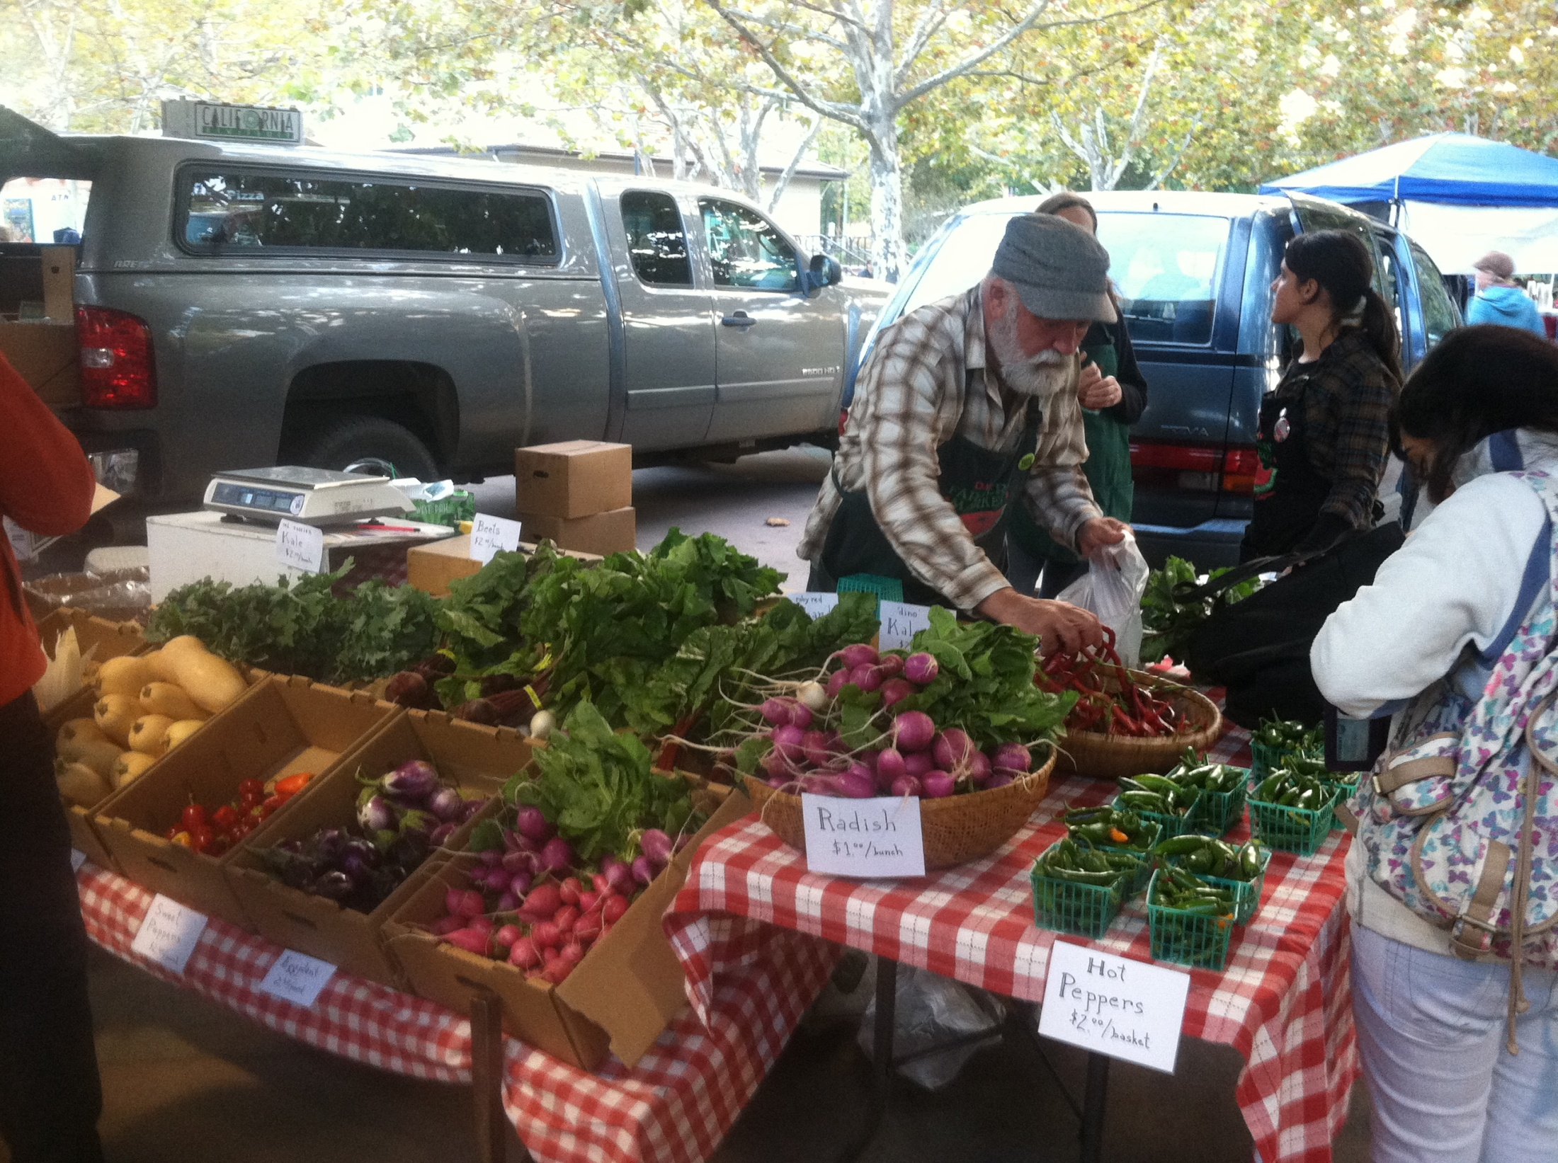

Lesson 2: Marketing
Photo: Marisa Alcorta
Notes:
Hi and welcome to Lesson 2 on Marketing.
Marketing is a critical part of your farm business. You can grow high quality, beautiful produce, but if you haven’t spent time figuring out where and how to sell it, you won’t be in business very long. It’s important to think about how you are going to sell those farm products, and make a plan for it, before you put a single seed in the ground.

Slide 2
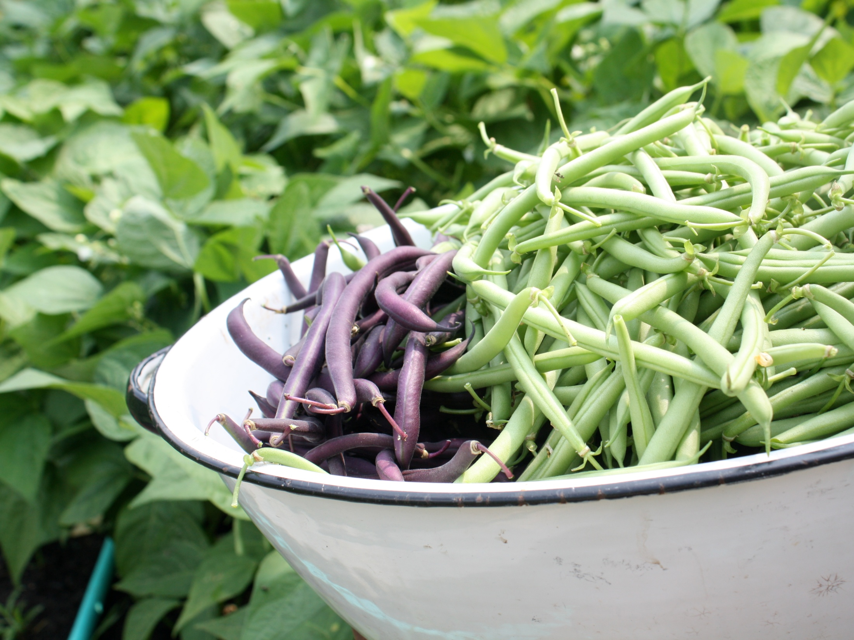
Lesson 2: Marketing
Part I: Basic marketing concepts
Part II: Distribution channels for selling your products
Develop a framework for your marketing plan
“Marketing Channels” are simply different ways to sell your products
Photo: beau-and-the-bean.blogspot.com
Notes:
There are two parts to Lesson 2. In Part I, we’ll cover basic marketing concepts that will help you figure out how to reach your customers, and manage your risk.
In Part II, we’ll spend some time exploring different ways to sell your products. You’ll hear us refer to these as “marketing channels”. By the end of this lesson, we want you to have the beginning of a marketing plan in place. A well thought-out marketing plan is an essential part of your overall farm business plan.

Slide 3
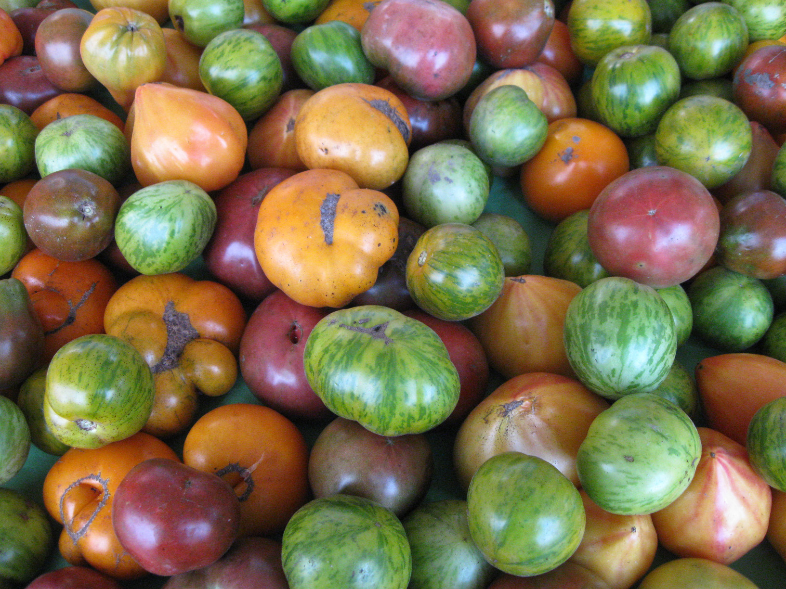
Marketing Part I: Basic Marketing Concepts
How to do market research
Customer values
How to find customers – building relationships
Risk management strategies
Aligning how you sell with how you work and live
Photo: http://www.broadripplefarmersmarket.org/category/photos/
Notes:
In Part I of the Marketing lesson, we will talk about some of the following Basic Marketing Concepts:
How to do market research
Customer values
How to find customers and build relationships
Risk management strategies – the importance of starting small and diversifying your markets
Aligning how you sell with how you work – taking into consideration your production style, your lifestyle & your values

Slide 4
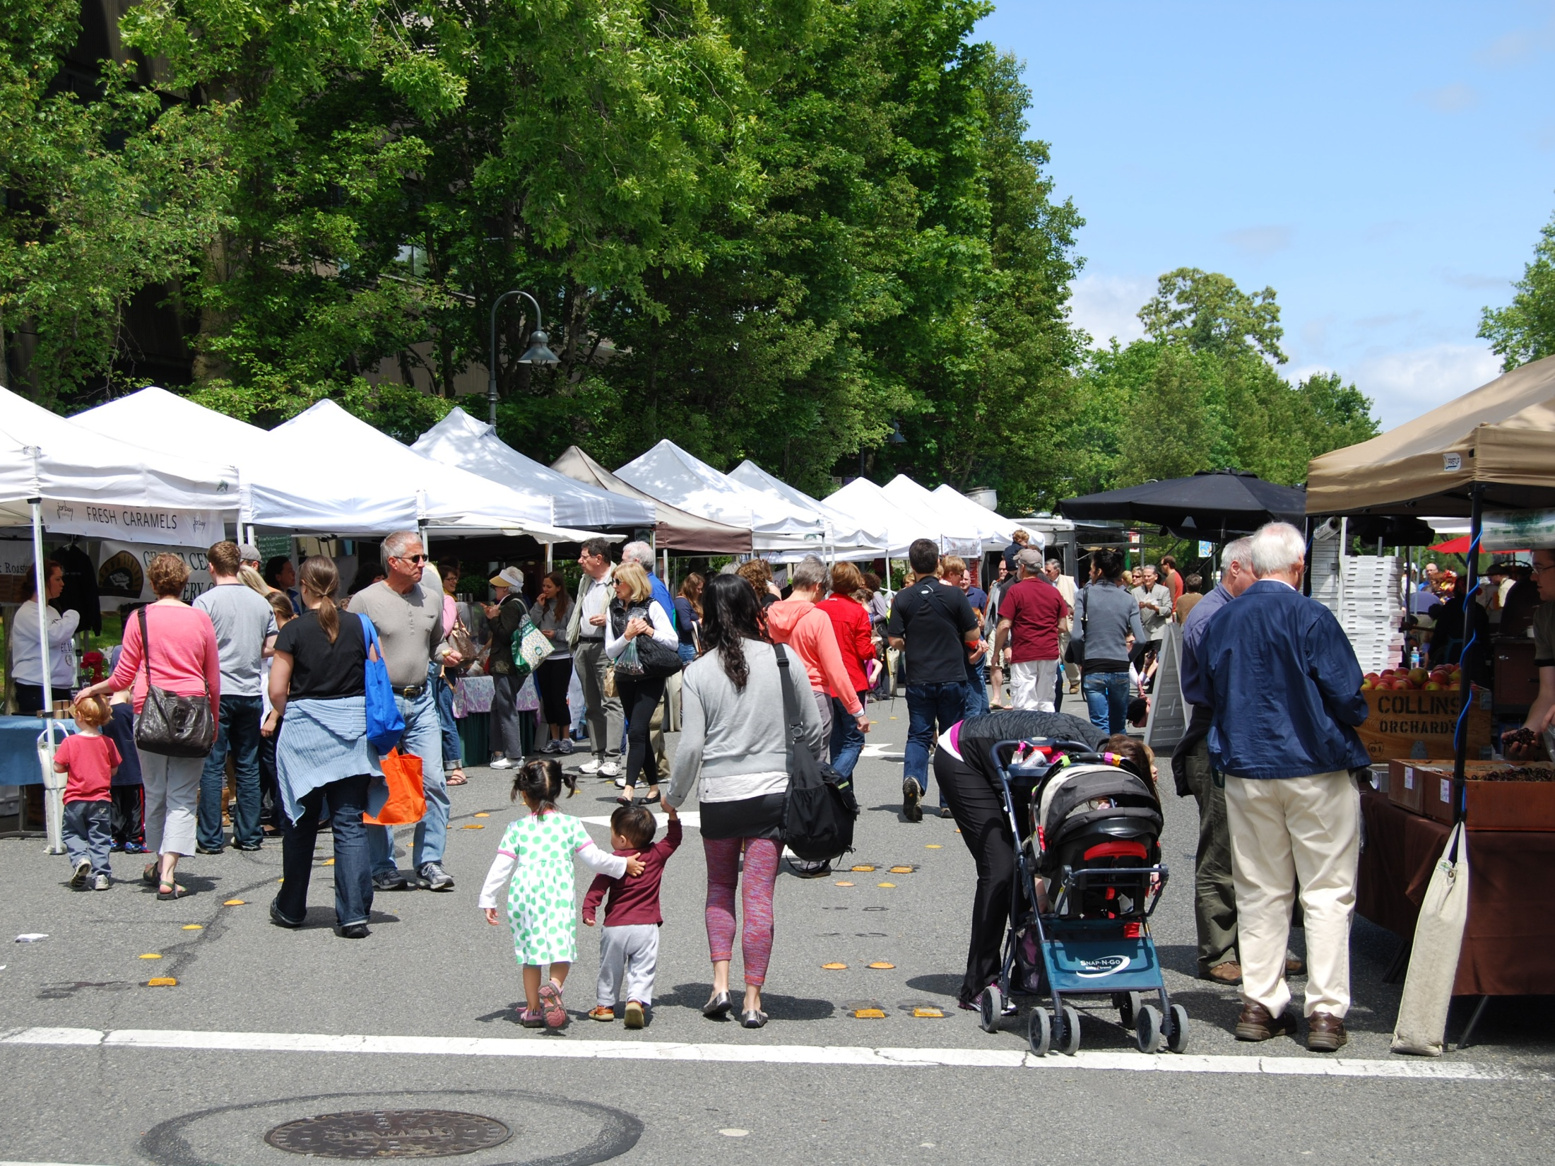

What is market research?
Who are your potential customers?
What do they want?
Photo: www.mifarmersmarket.org
Notes:
Let’s get started with Market Research! What exactly is market research? Market Research is one of the most important parts of your business plan. It means figuring out who your ideal customer is, and what they want.
Sounds easy enough, but how do you figure this out?
Let’s hear from a farmer in North Carolina about how she did her market research. This is Shiloh Avery with Tumbling Shoals farm.
→ Insert Shiloh’s interview clip
Let’s hear from a farmer in North Carolina about how she did her market research. This is Shiloh Avery with Tumbling Shoals farm.
→ Insert Shiloh’s interview clip

Slide 5
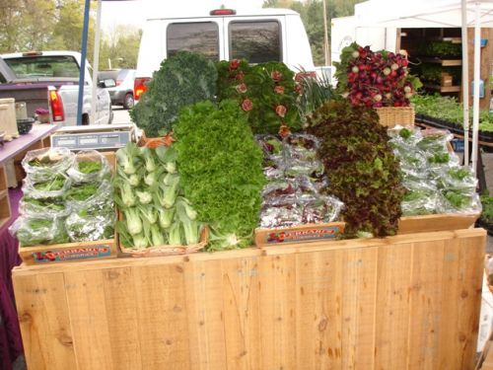
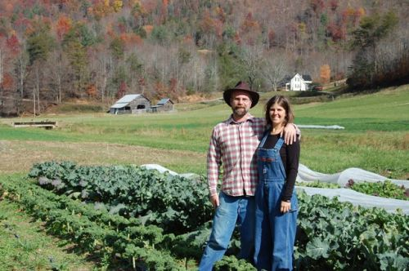
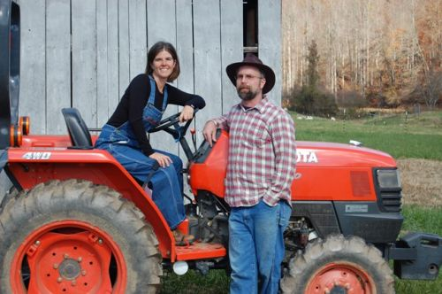
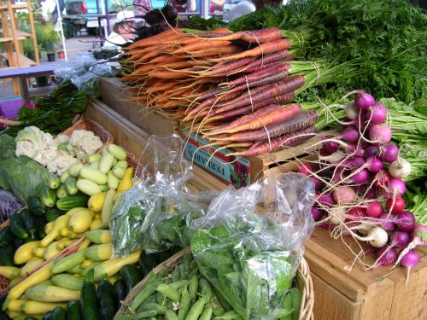

Slide 6
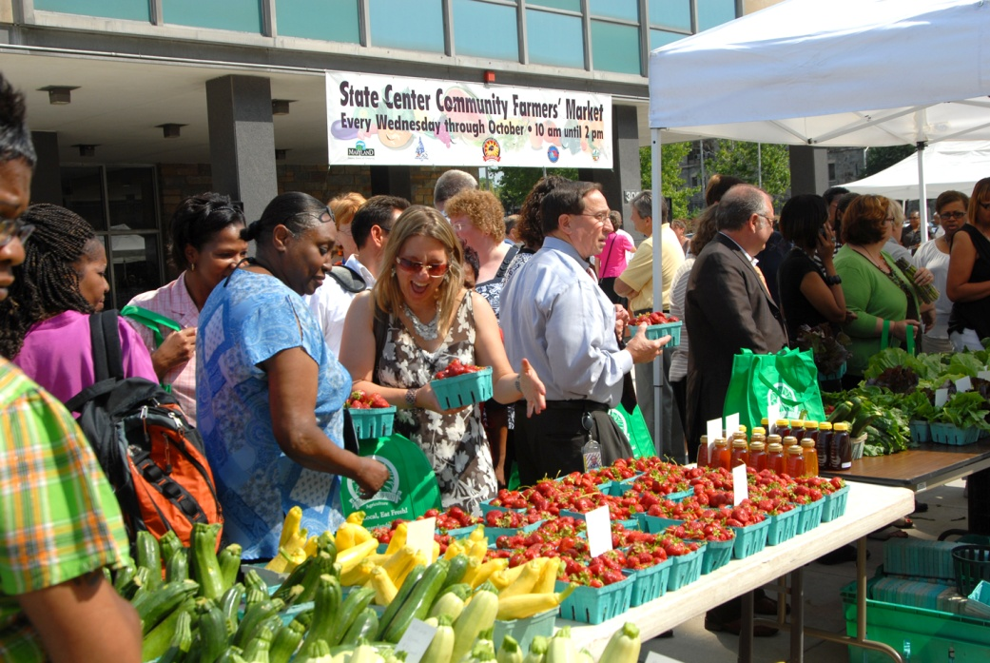
Market Research “Demographic Information”
Level of Education
College educated
Bachelor’s? Graduate Degrees?
Level of Income
$30-50,000?
Above $50,000?
Photo: www.blatimoresun.blogspot.com
Notes:
Thanks Shiloh! That was a lot of information, so let’s review some of what she said. Shiloh first mentioned identifying demographic information. Demographic information describes social and economic characteristics of a certain population. For example, the characteristics that Shiloh mentioned she was looking for in her customers were that they were college educated, and not necessarily rich but had a certain level of disposable income. Shiloh wants these people to be her customers because she thinks they will know the value of good food, and they have the money to pay the prices she wants to charge for it.

Slide 7
Market Research “Demographic Information”
Find demographic information through the US Census Bureau
Public Library
Website
FactFinder Tool
Look at Marketing Resources for more information
www.factfinder2.census.gov/
Photo: www.blatimoresun.blogspot.com
Notes:
You can find demographic information about the population of a certain area through the US Census Bureau. This information is at the public library, and also on the web. The Census Bureau has a FactFinder tool online you can use, and we’ve listed others on the Marketing Resources.

Slide 8
Market Research “Demographic Information”
Lifestyles Of Health and Sustainability (LOHS)
People who care about their health care about their food
Important for selling directly to consumers
Jogging, biking, and exercise in general is an indicator
Photo: www.baltimoresun.blogspot.com
Notes:
Shiloh was also looking for people who cared about their health as potential customers. She mentioned looking for Lifestyles of Health and Sustainability. What’s the connection here? Studies have shown that people who care about their health care about their food. And because she planned to sell directly to her customers, she could look for signs of a population that might be more interested in health and food by using the indicator of exercise.

Slide 9
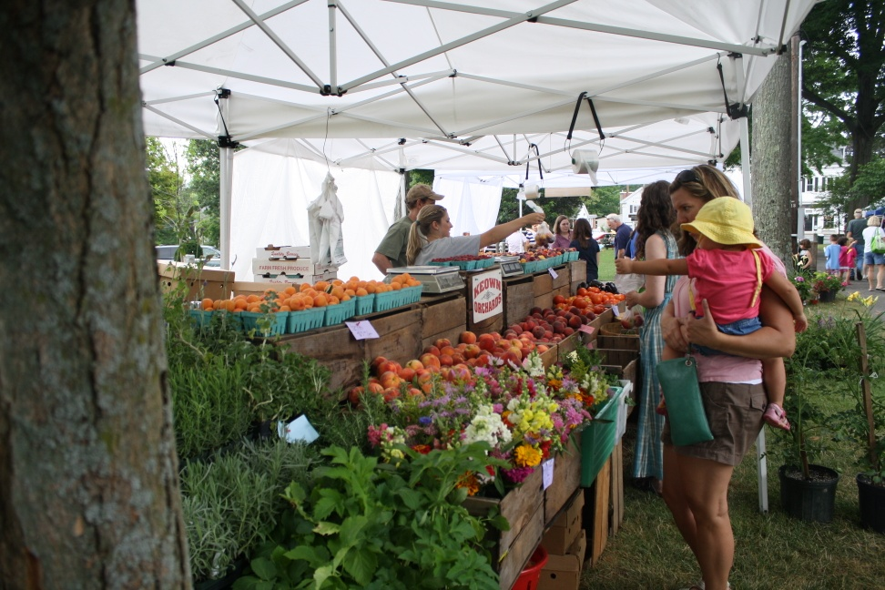
Market Research “Making Observations”
How much produce are farmers bringing to the market?
Counting customers gives you an idea of how much business a farmer might be doing
What’s missing?
A “niche” is a distinct segment of the market
Photo: www.graftonfarmersmarket.com
Notes:
Because Shiloh was planning to sell at farmers markets, she actually spent the entire day at the market making observations. These observations included: the kind of volume vendors were selling in terms of produce, counting the number of customers at a stall, and getting a general feel for how much business was happening at the market. She also was looking for what was missing, and discovered that one particular farmers market didn’t have early or late season produce. Shiloh saw this missing piece as an opportunity, and took advantage of it. This can also be called a “niche”, which is defined as a distinct segment of a market. We’ll talk about this and give more examples of niche markets in a few minutes. In this case, the niche was the need for early and late season produce. Making these kinds of observations about any type of market is an important part of market research.

Slide 10
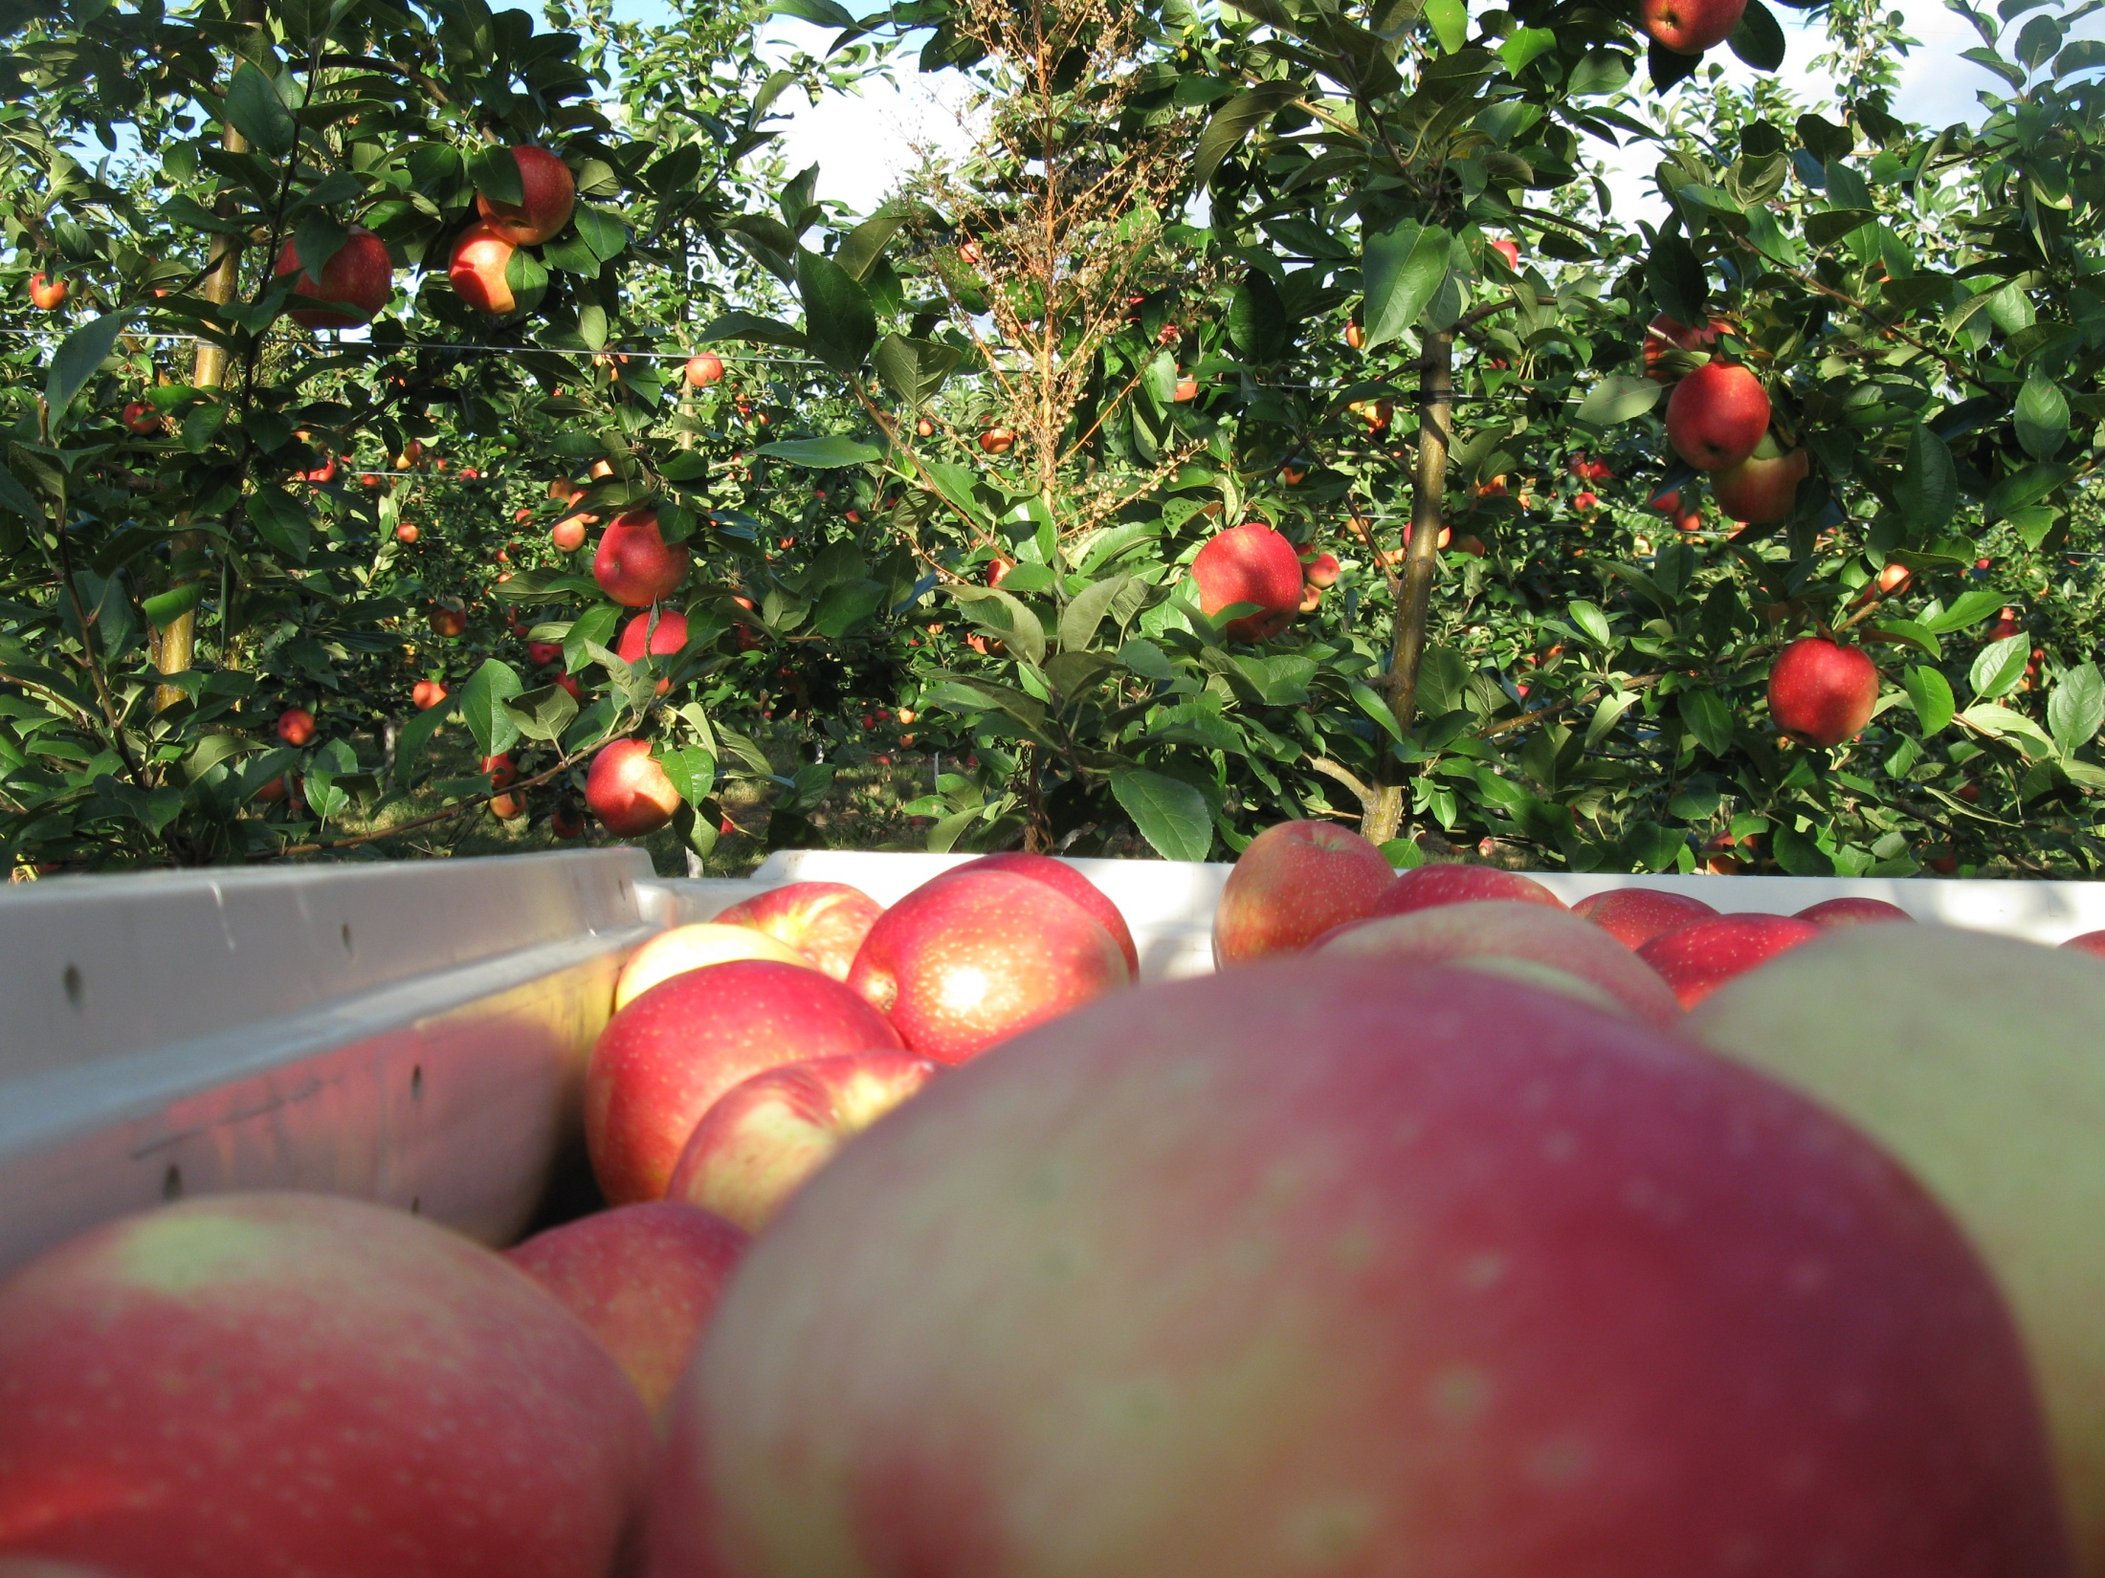
What is market research?
Talk to people!
Restaurant Chefs
Grocery Store Buyers
Local Produce Distributors
Farmers Market Managers
Photo: www.sweettango.com
Notes:
Another part of market research is getting out there and talking to people in the markets that you are most interested in selling to, particularly for customers such restaurant chefs, grocery store buyers, local produce distributors, or farmers’ market managers. Shiloh said she found natural food stores and restaurants by reading local food guides, but you can also use the phone book and word of mouth. She called them and asked them questions about where they got their food and if they would be interested in purchasing from a local farmer.

Slide 11
Market Research Questions
Are you interested in buying from local farmers?
What are some products you would be interested in? What’s missing?
What are some emerging trends?
What is important to you about your food?
Photo: beau-and-the-bean.blogspot.com
Notes:
After you’ve identified some markets you might be interested in selling to, call them and ask them questions about how it might work. If you aren’t comfortable having this conversation in English, find a friend or family member to help you. Here are some good questions to start with:
-Are you currently buying products from local farmers? If not, are you interested in doing that?
-What products would you be interested in buying from a local farmer? What are you missing?
-What new products do you think are emerging trends?
It may also be useful to ask them what is important to them about their food. Is it just price, or are there other things too? This last question is significant, because it gives you an idea of what your potential customers might value about their food.

Slide 12
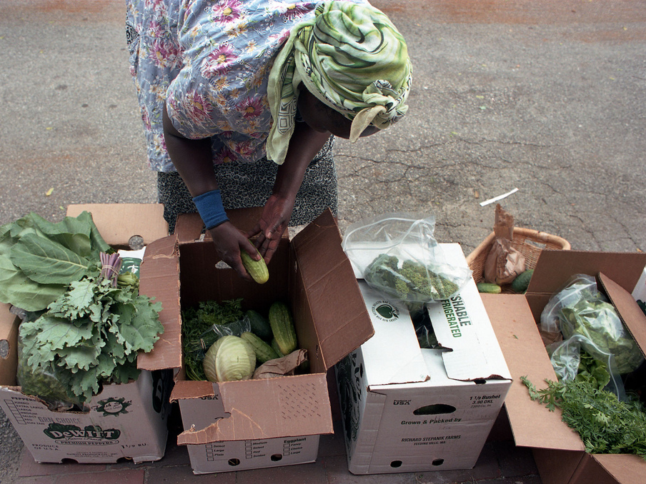
What do your customers want?
Photo: Fresh Start Farms, ME
Notes:
And that’s the 2nd basic marketing concept we wanted to talk to you about – customer values, or figuring out what your customers want. Customers often value more than just the physical product they buy, and sometimes they’re willing to pay more for things that have the qualities they are seeking. Here are some examples:

Slide 13
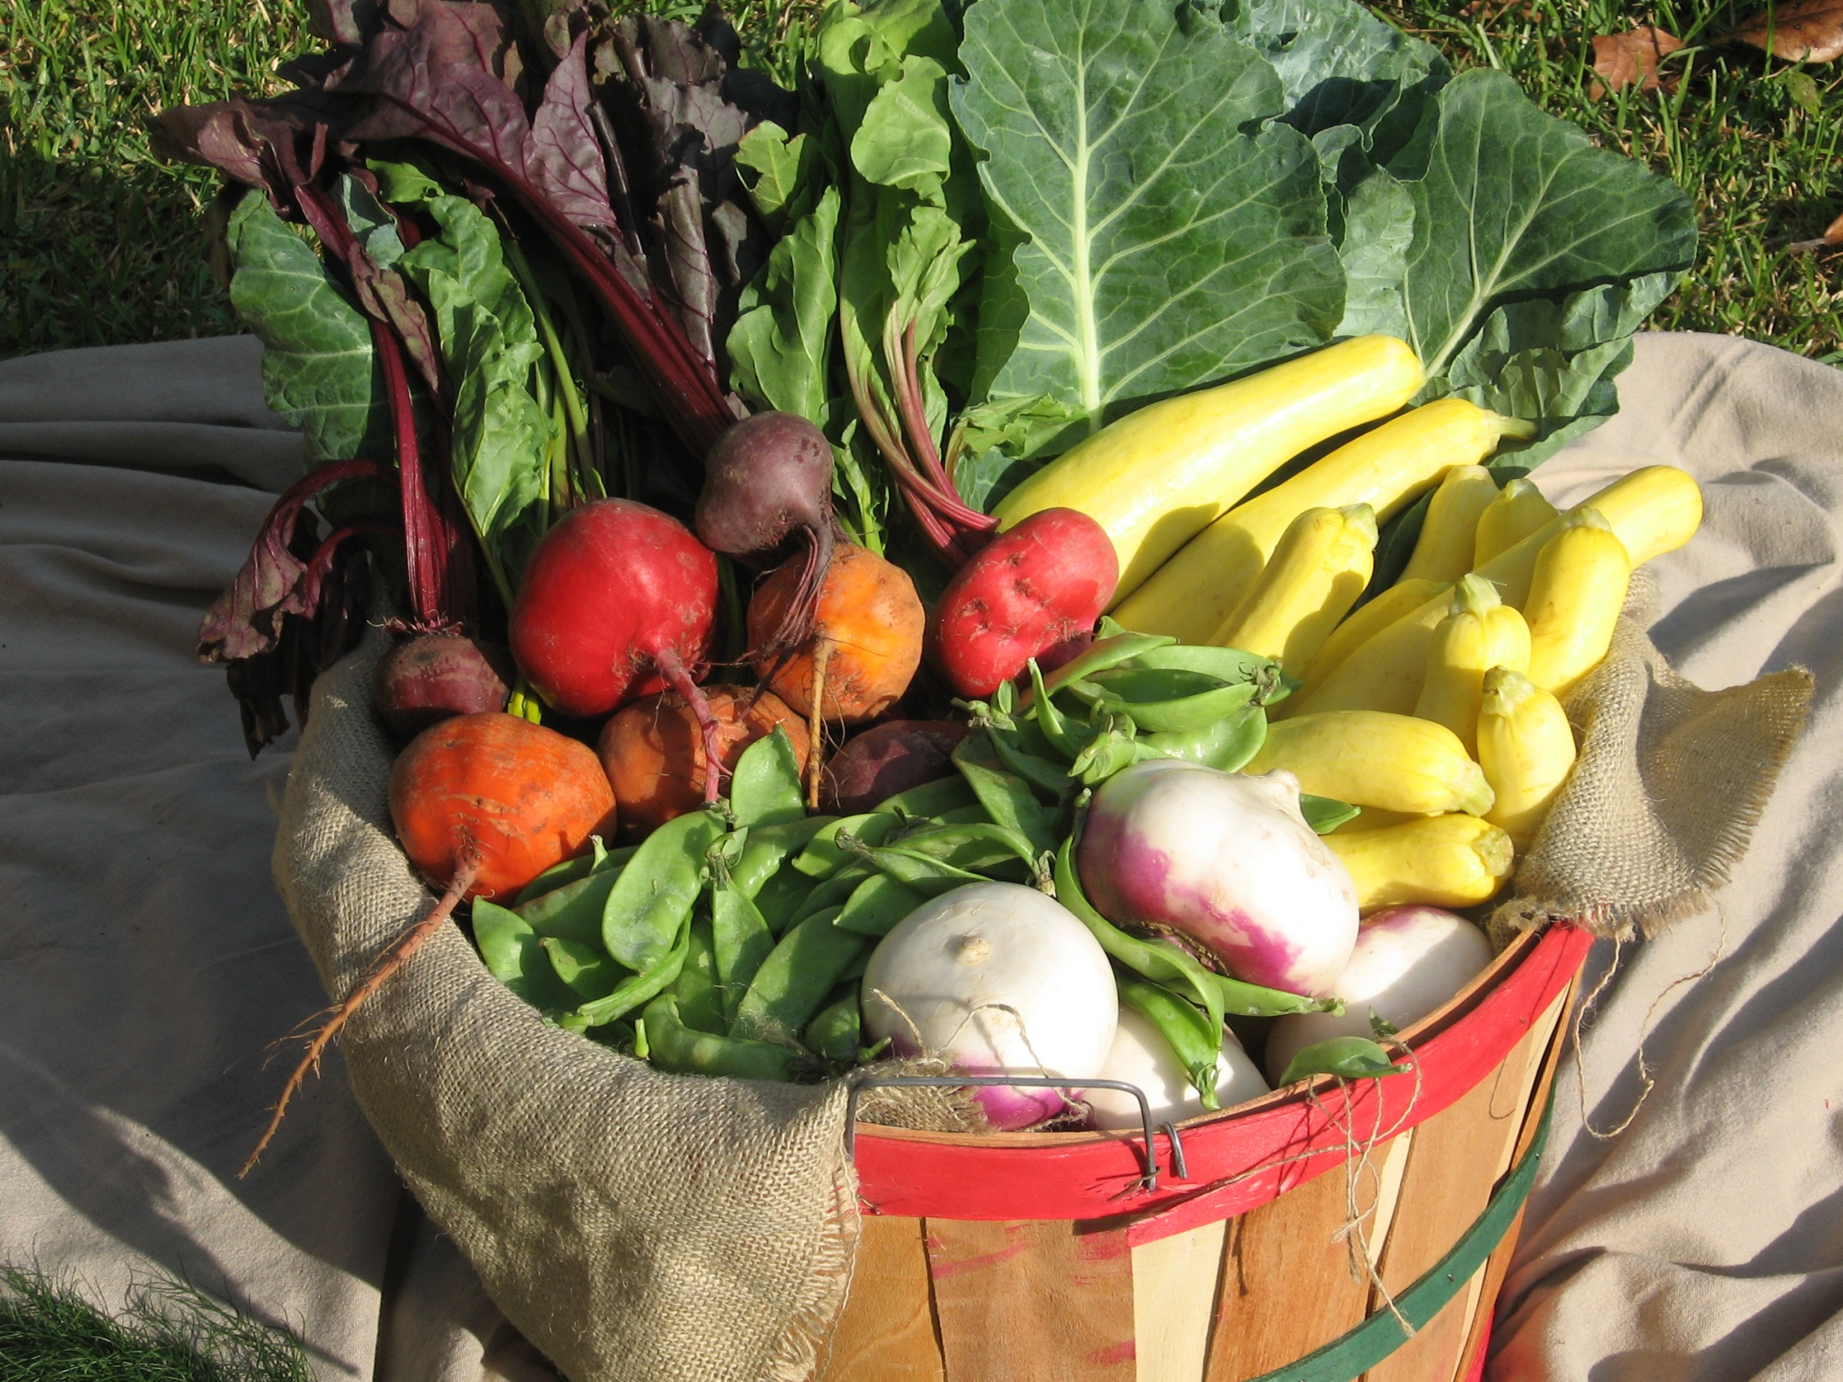
Quality
Fresh, beautiful produce with excellent flavor
Photo: www.offthevine.org
Notes:
Most customers want a high quality product. They want fresh, beautiful produce with an excellent flavor, and in some markets, higher quality commands a higher price.

Slide 14
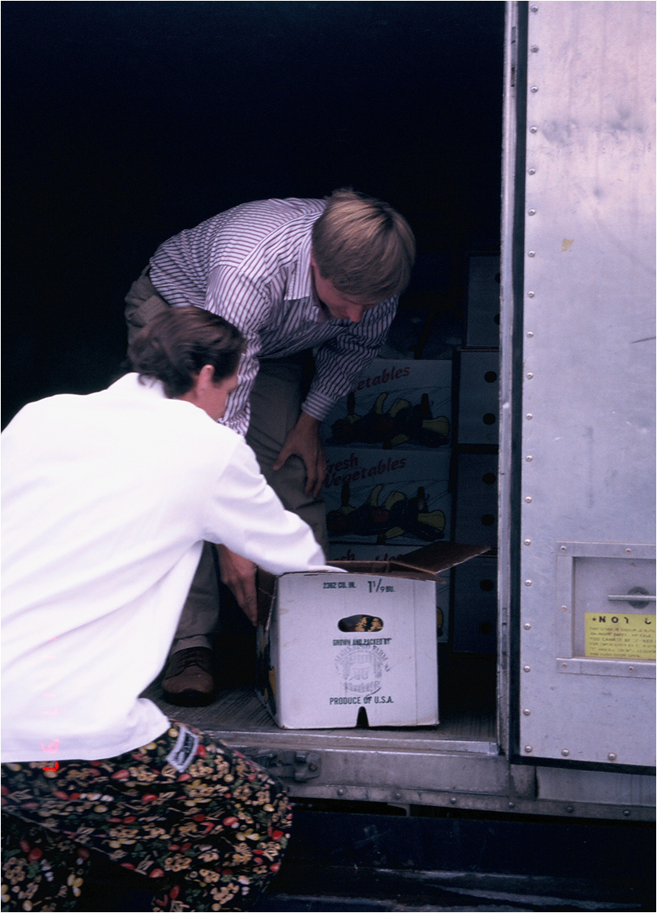
Convenience
Easily accessible, or frequent deliveries
Photo: Markristo Farm, MT
Notes:
Some customers really value convenience. Some restaurant chefs will value having products delivered to their kitchens, and some chefs would prefer to pick out their own produce fresh from a farmers market down the street.

Slide 15
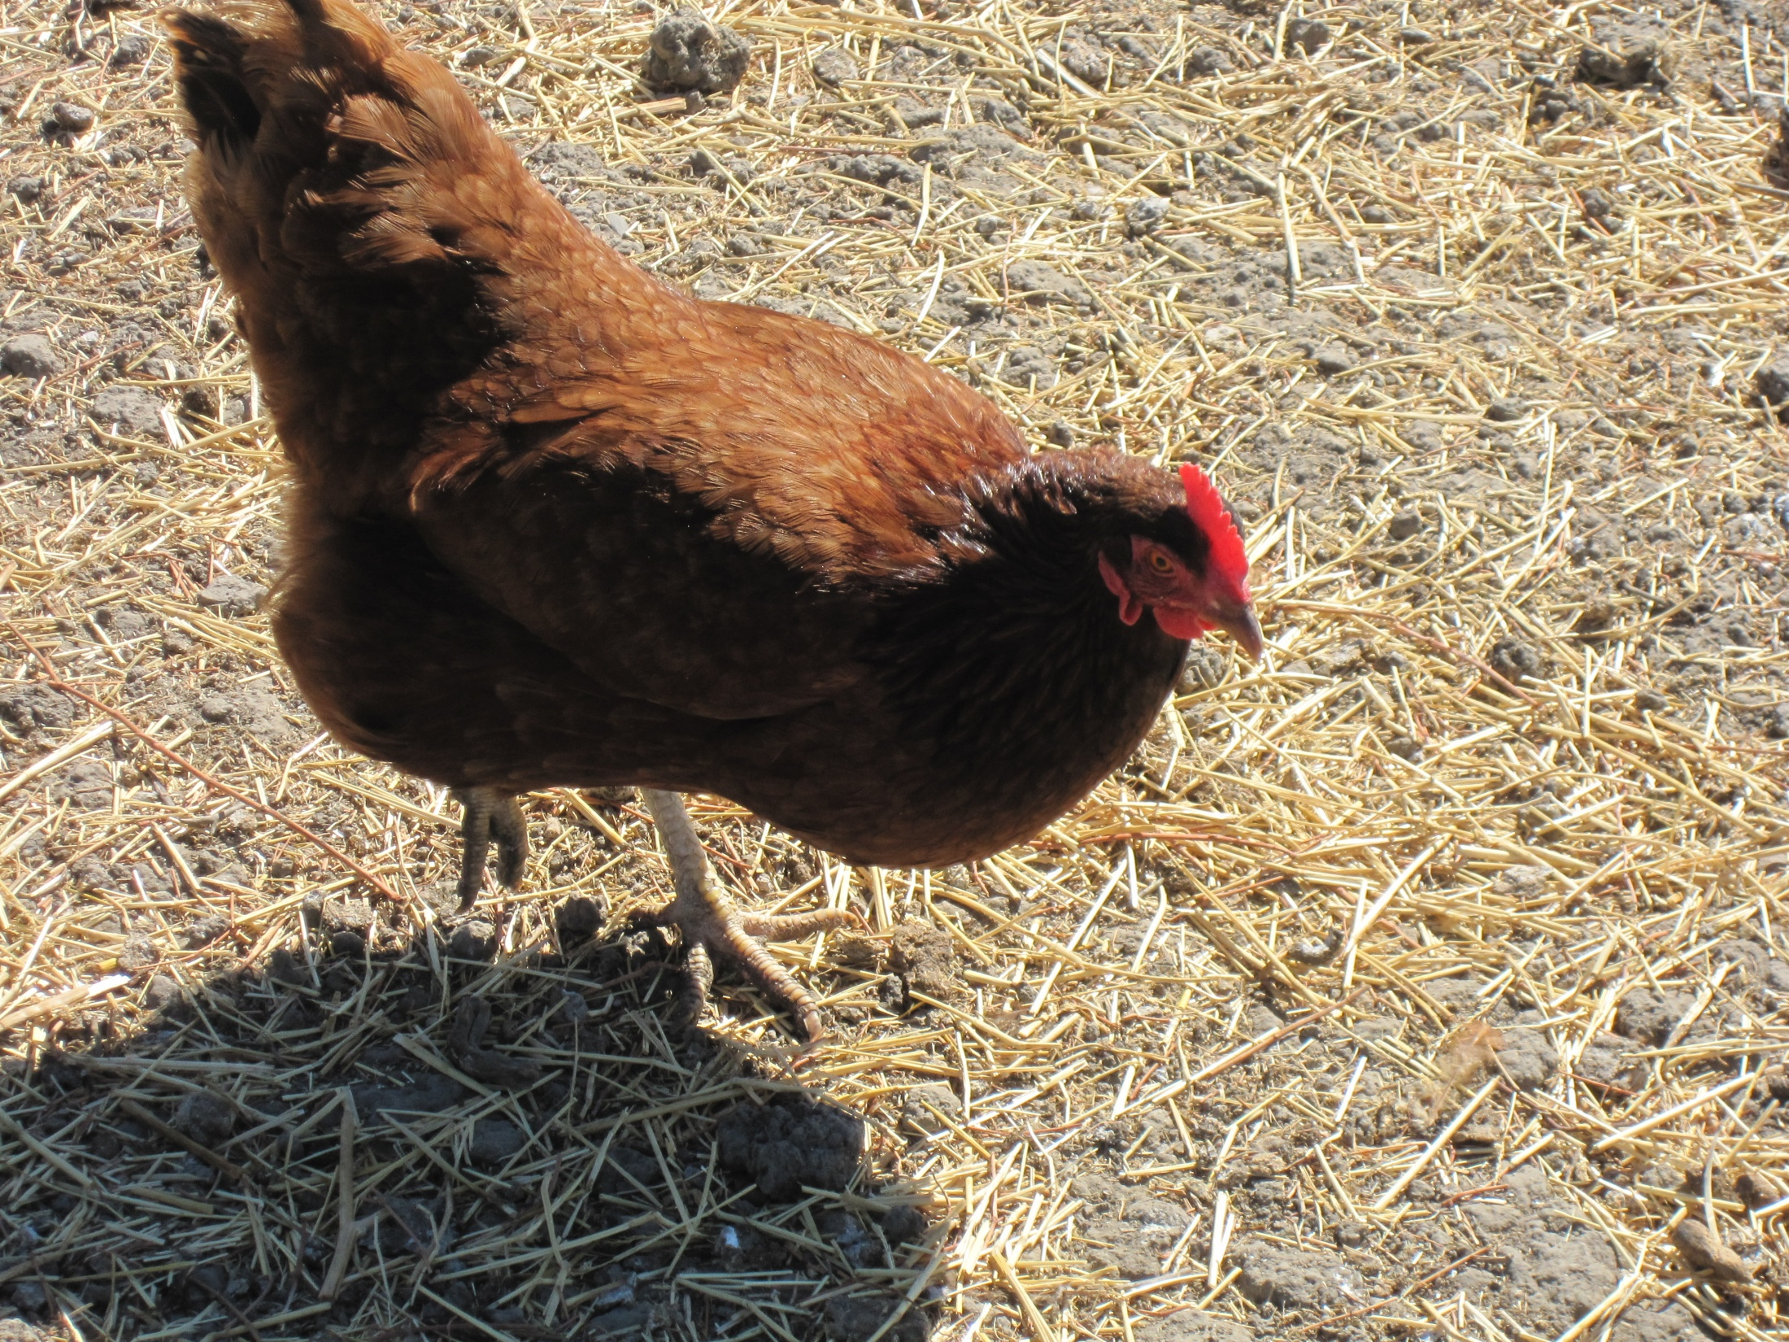
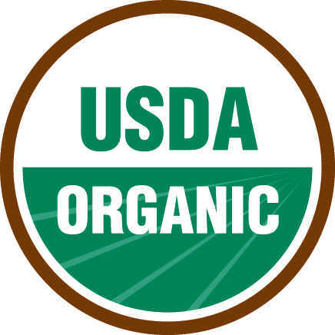
How and where it was raised
A personal connection with the farmer, local, organic, grass-fed, free-range, pastured
Photo: Marisa Alcorta
Notes:
Some customers place a high value on knowing how their produce was grown and raised. They want a personal connection with the farmer. Some will also value standards that help them know the methods of growing, such as certified organic. Others want to know how the animals they are eating are being treated, and how they are raised. It’s important to learn how to label your products to send the right message to your customer

Slide 16
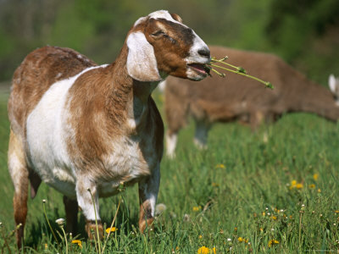
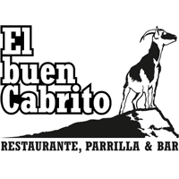
Catering to cultural diets
Halal, kosher, organ meats, cabrito, asian vegetables
Photo: www.litscapeart.com
Notes:
There is also a segment of customers that will highly value your knowledge of their cultural diets, which may be pretty different from the standard American diet. These customers will be looking for labels that show you understand their religious or cultural preferences, such as Halal or Kosher, or they will be looking for specialty cuts of meat, like brisket or tri-tip, or parts of the animal used in different cultures, like tongue and baby goat, known as cabrito. They might also be looking for types of vegetables they are familiar with from other regions of the world.

Slide 17
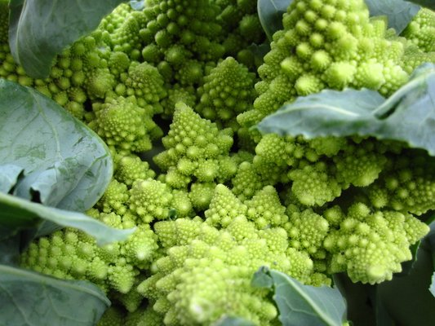
Niche Markets
Staples like grain or beans
Specialty crops like fancy garlic, ginger, salad mixes, or unusual looking things like colored cauliflower or radishes
Items for chefs or gourmet restaurants
Bulk quantities such as root crops or crops for freezing or canning
Early or late season produce
Winter crops
Photo: yelp.com
Notes:
These are just some examples of a few things that your customers might value. These values are also called “Niche Markets.” As I mentioned earlier, a niche is defined as a distinct segment of the market. It may be a specific crop, or a time of the year, or it might even be an activity that someone needs produce for, like freezing and canning. A niche is simply a demand, a need or a value in the community. On your screen is a list of some other examples of niche markets. Some farmers find success by focusing on a particular niche and catering to those customers.
Spend some time thinking about what other things your customers might value. Is there a particular “niche” in your community that you might be able to fill?

Slide 18
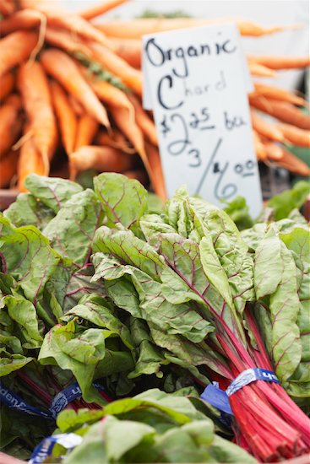
What about low prices?
Do you know how much it costs you to produce that crop?
Can you maintain excellent records?
Find a niche that customers value to make money
Notes:
Ok, so now let’s talk about price. Is offering a low price considered a niche? While most customers will value a low price, low prices is not really a niche, because your price isn’t something that comes from the community. Your price comes from knowing how much it costs you to produce your product! Competing only on price can be dangerous. In order to offer lower prices than what you see in the market, you have to know exactly what it costs you to produce your products. Do you know how much it costs to grow one head of broccoli? If it costs you $2.00 to grow that broccoli plant, and you sell it for $1.00 at the market, you are losing money by selling it, not making money! Figuring out what it costs you to produce your crops takes time, and very good recordkeeping. Are you a good record keeper? Do you know how much of your expenses (like your fuel, your labor and your water) are going to produce are particular crop? We’ll talk more about this in Lesson 3. Most beginning farmers don’t know exactly what it costs them to produce their crops their first year, or even first few years, until they have established their systems and are keeping good records. This is why trying to offer a lower price than other farmers your first year is not a good idea. Instead, a successful farmer will find creative ways to provide value to his or her products that customers are willing to pay more for, such as the niches that we talked about previously.

Slide 19
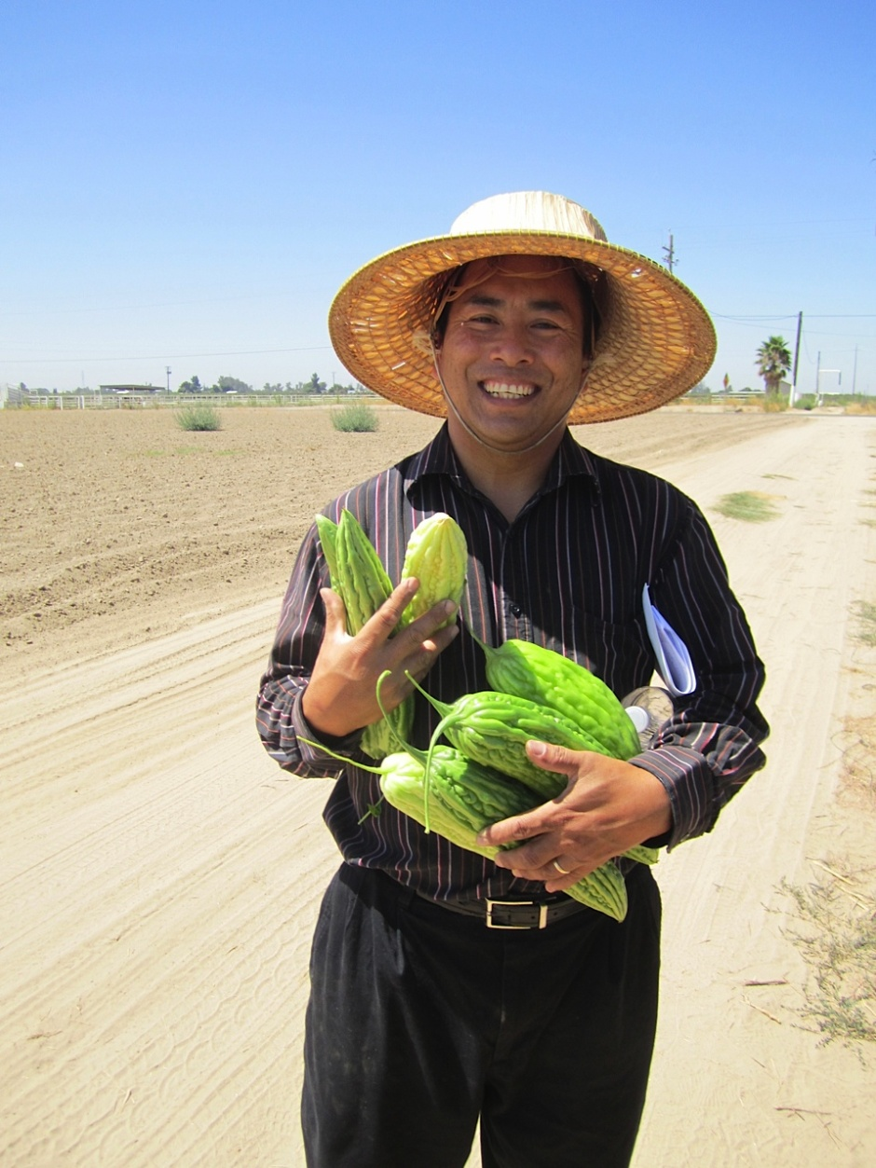
Building Relationships with Customers
Photo: Luis Sierra
Notes:
This leads us to the next basic marketing concept, which is how to find customers, and how to build relationships with these customers. As we mentioned earlier, many people want to know more about who is growing their food, where it comes from, or why it is different. As you do your market research and meet people, they will want to know about you, your farm, and your produce. How will you make sure that they remember you?

Slide 20
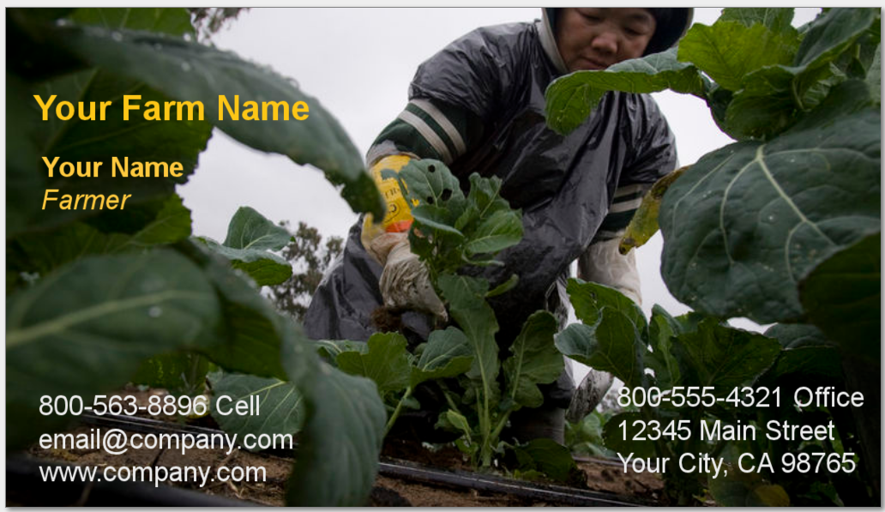
How will they remember you?
Business Cards
Photo: Victor Bareng
Notes:
Start with a business card. One of the simplest and most effective things you can do is make a business card. This is an easy way to help people remember who you are. When you meet a buyer, or bring in samples, you should hand them a business card immediately. This way, they can associate your name with your products, and have a way to contact you if they want to purchase your products. You will want to make sure you have a reliable way to communicate with you on the card.

Slide 21
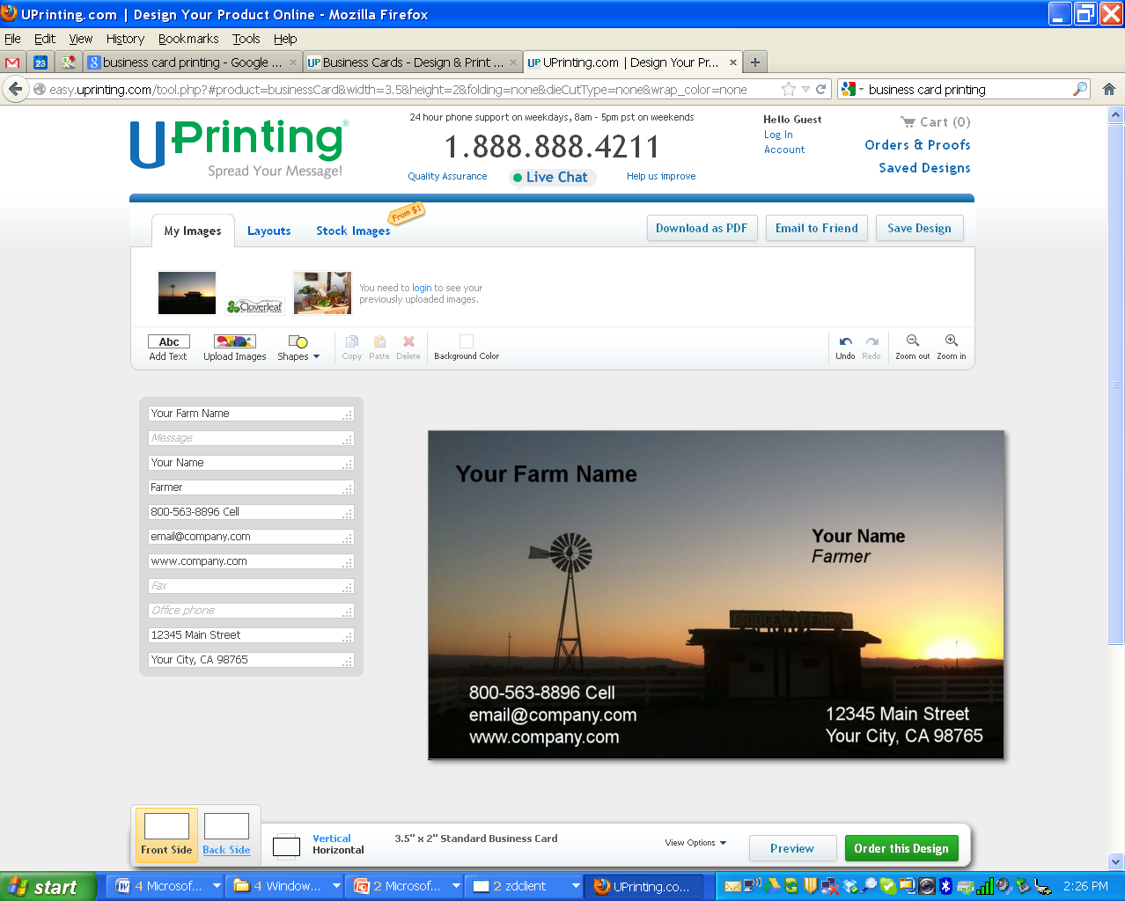
Make Your Own Business Cards
Google search “Business card printing”
www.uprinting.com design your own, 250 for about $17.00
Notes:
Business cards are very easy to make, and there are many websites that will let you design your own card and will even print it for you. For example, this company, Uprinting.com will let you design your card with your own pictures, and you can make 250 cards for about $17.
This picture is a screen shot from the uprinting webpage. It’s easy to navigate, but have a friend or family member help you with it.

Slide 22
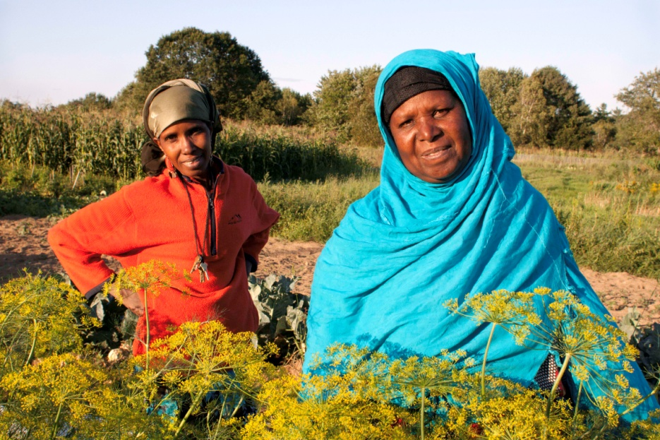
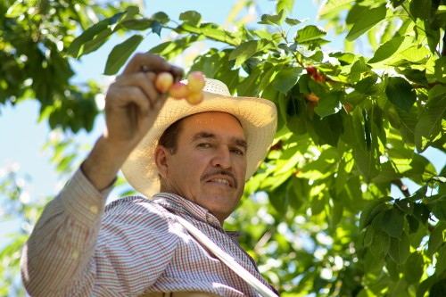
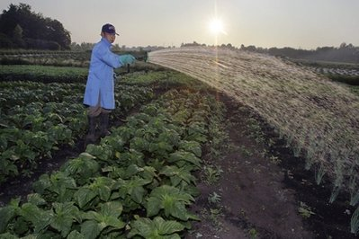
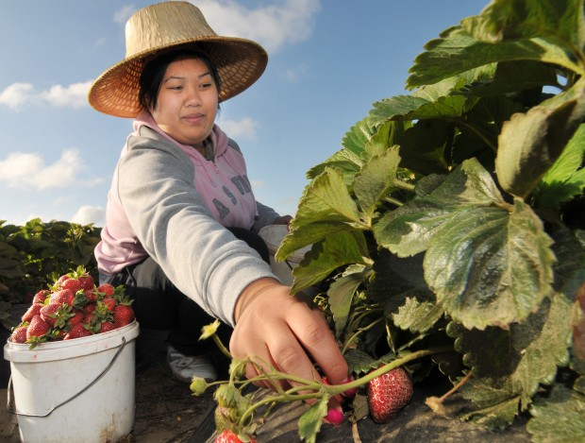
How will they remember you?
Photo: Fresh Start Farms, ME
Photo: hispanicallyspeakingnews.com
Photo: nesfp.nutrition.tufts.edu
Photo: Victor Bareng
Notes:
Another way to help people remember you is to tell your story. David Visher, a marketing specialist in California, notes that more and more people want to know where their food comes from, and who grew it. They want to buy products which may be local, or organic, or grown on a small farm or by a family, or by an underrepresented or immigrant farmer. They want to know your story.

Slide 23
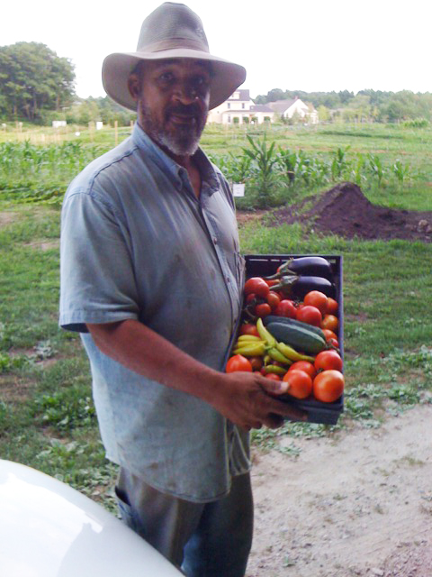
How will they remember you?
Written Marketing Story
Who are you and where do you farm?
What you grow?
What makes your product special?
How can buyers contact you?
Include pictures – the more the better!
Photo: encoreleaders.org
Notes:
David recommends writing your story down, and practicing telling it. He says that the purpose of a written document is to have something you can give to buyers that will make them want to keep talking to you, and also remember you. You don’t have to cover everything. You need a unique marketing story that is short and persuasive.
Attached to this slide is a worksheet that you can fill out with basic questions that will help develop your story. The questions are simple – who are you, what do you grow, what makes your product special, and how can someone contact you? Pictures are critical to make your story sheet attractive! Here are some examples of what it can look like.

Slide 24
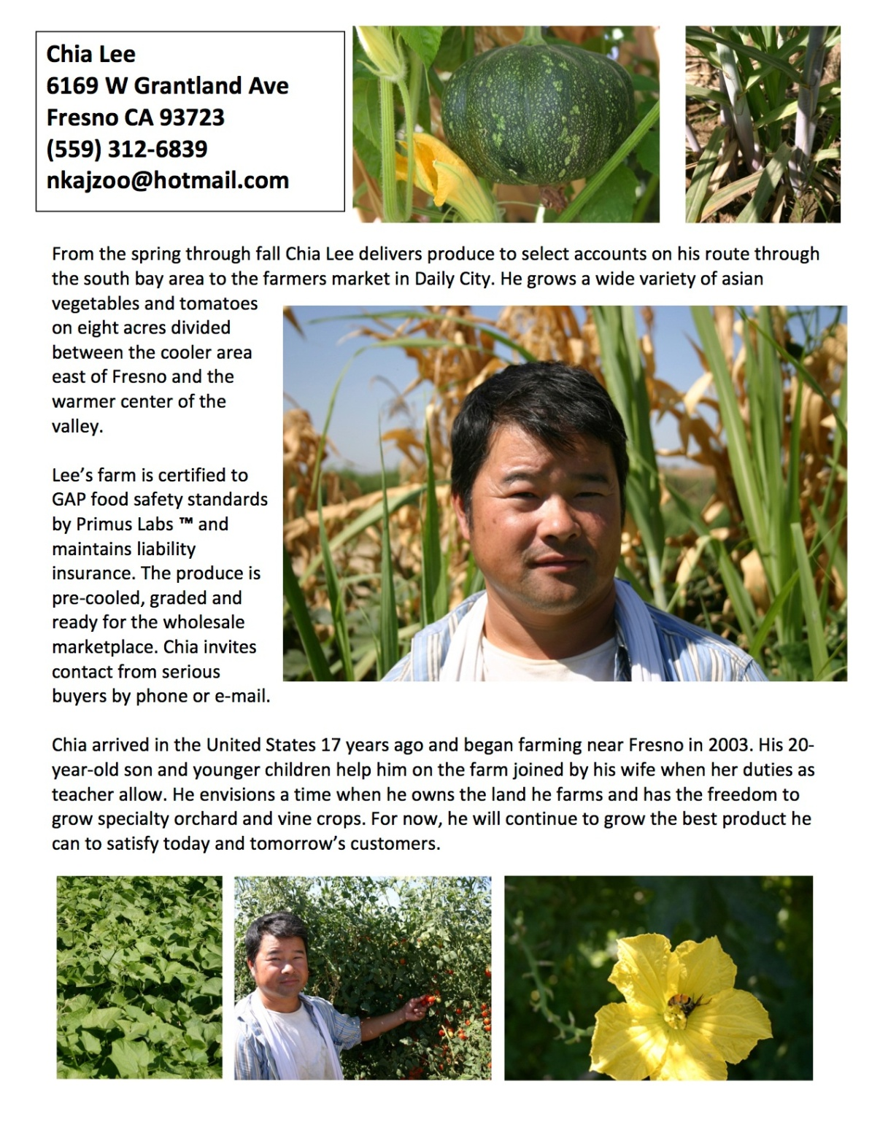
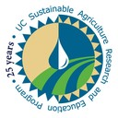

Materials developed by: David Visher & Gail Feenstra, University of California Sustainable Agriculture Research and Education Program (UC SAREP)
With support from: California Department of Food and Agriculture (CDFA) through the Specialty Crop Block Grant (#SCB11001)
Photos: Luis Sierra
Notes:
David and his project at the University of California helped Chia Lee create this simple sheet that talks about his farm, his production techniques and his personal story. The pictures will help buyers remember his face, and also illustrate the quality of some of the crops that Chia grows.

Slide 25
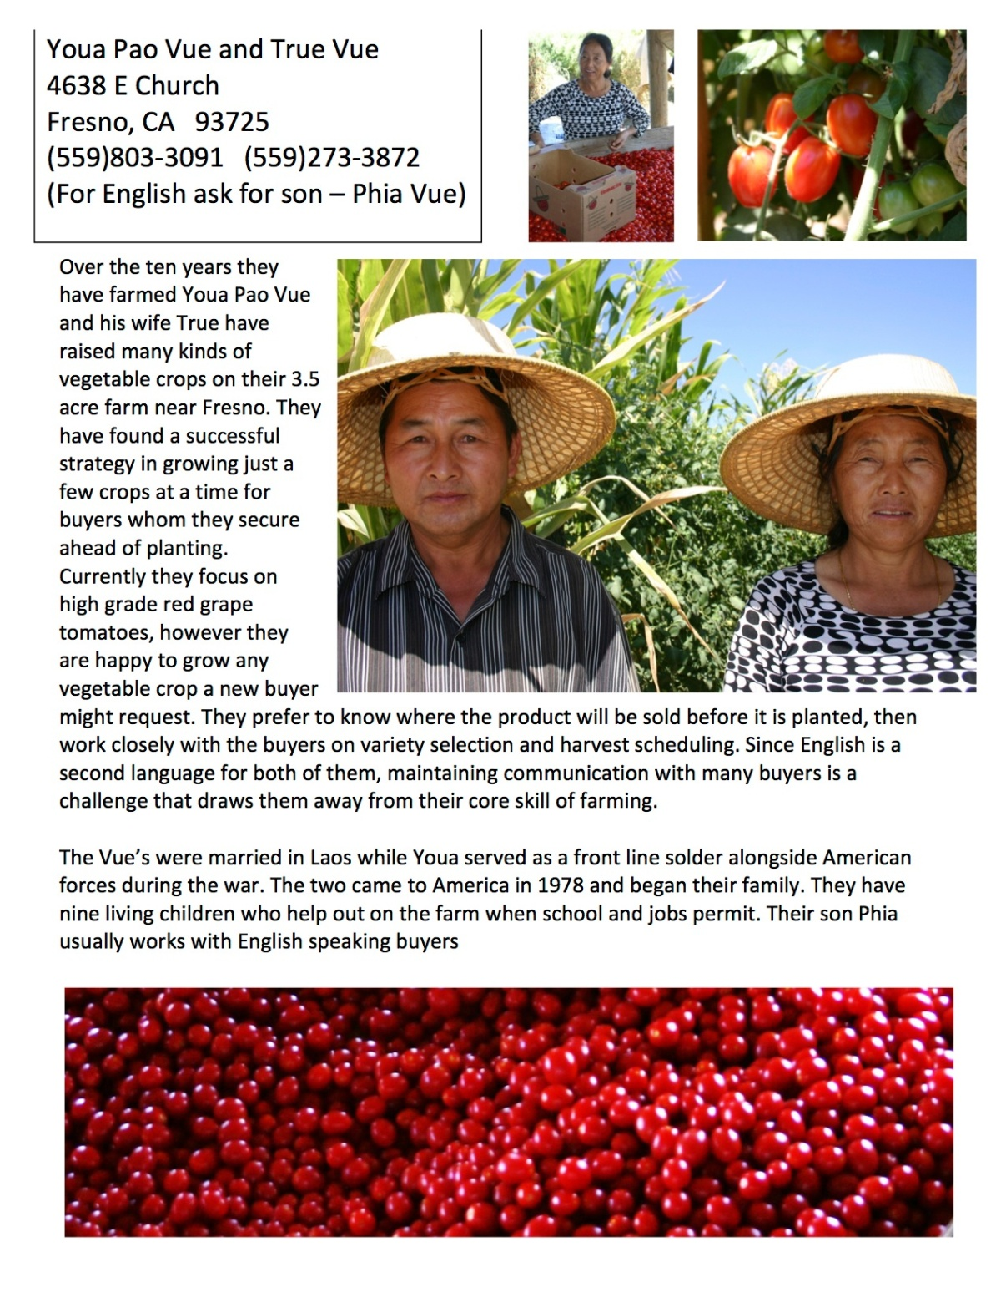
Materials developed by: David Visher & Gail Feenstra, University of California Sustainable Agriculture Research and Education Program (UC SAREP)
With support from: California Department of Food and Agriculture (CDFA) through the Specialty Crop Block Grant (#SCB11001)
Photos: Luis Sierra
Notes:
This is another example of the type of simple marketing sheet that shows off the product, the farmer and tells their story.

Slide 26
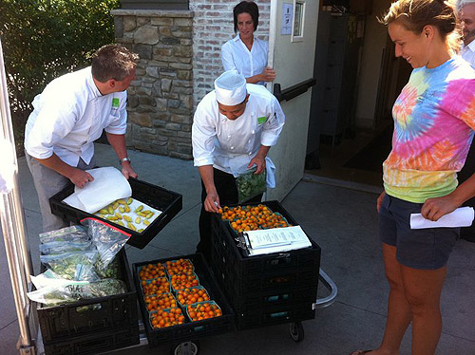
Building Relationships
Follow through with your commitments
Buyers need to trust your quality
TRUST
Photo: wegmans.com
Notes:
These are things you can do to let people know who you are and keep you in mind. But the real secret to building relationships is trust, which in the farming world, translates into two things: following through with your commitments, and producing high quality products.

Slide 27
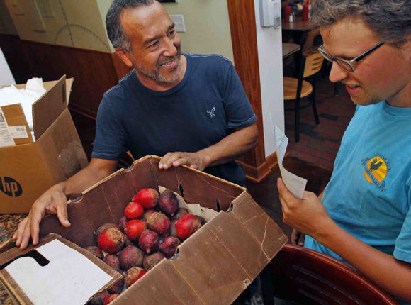
Follow through with your commitments
Communicate immediately about changes or problems
Be on time
Keep your word
Respond quickly to calls or emails
Photo: newsobserver.com
Notes:
Following through on your commitments means that you do what you say you are going to do, and you don’t change your mind a few weeks later. You arrive on time, you keep your word, and you return a buyer’s phone calls immediately. This is how you keep your customers happy, and build a good relationship with them. Some buyers don’t want to work with small farmers because they have had bad experiences. One farmer started selling to someone else in the middle of the season, and left the first buyer without any produce. This created a bad relationship. Something to understand about markets in general is that prices are constantly changing during the season for each crop, they will go up and down each week. If you agree to sell to someone, they need to be able to count on you, as this creates trust.

Slide 28
Trust your quality
Quality needs to be consistent throughout your product
It’s hard to recover from a bad reputation
Photo: Victor Bareng
Notes:
Buyers need to trust your quality. If someone agrees to buy 10 cases of strawberries from you, they expect to get 10 cases of high quality strawberries. If later they discover that the top case of strawberries was perfect but the rest (or even a few) were poor quality, you have betrayed this person’s trust and they will most likely not buy from you again. You will also earn a reputation for being dishonest and they may tell others not to buy from you.
They key to developing good markets for your products starts with creating good relationships built on trust for quality products and following through on your commitments.

Slide 29
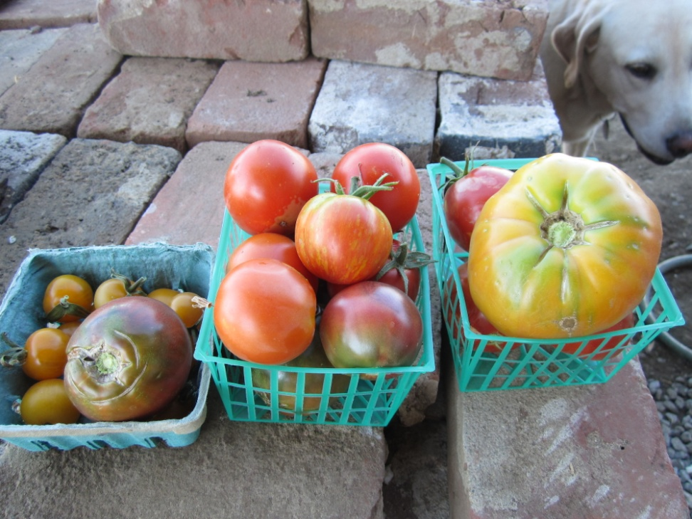
Risk Management
Start small and grow after your production skills become strong
Produce a small amount of something and give out samples to markets you want to try out
Ask for feedback on quality, ripeness and flavor
Photo: Marisa Alcorta
Notes:
This leads us to the next basic marketing concept, which is risk management as a strategy. One of the most important strategies for managing risk is to start small and grow after your production skills become strong. This not only applies to your production in general, but also to how much you offer your markets. Produce a small amount of something you’d like to sell and give out samples to markets that you would like to try out. Ask for feedback on the quality, ripeness, flavor and use that information to improve your practices, and establish a relationship with that market.

Slide 30
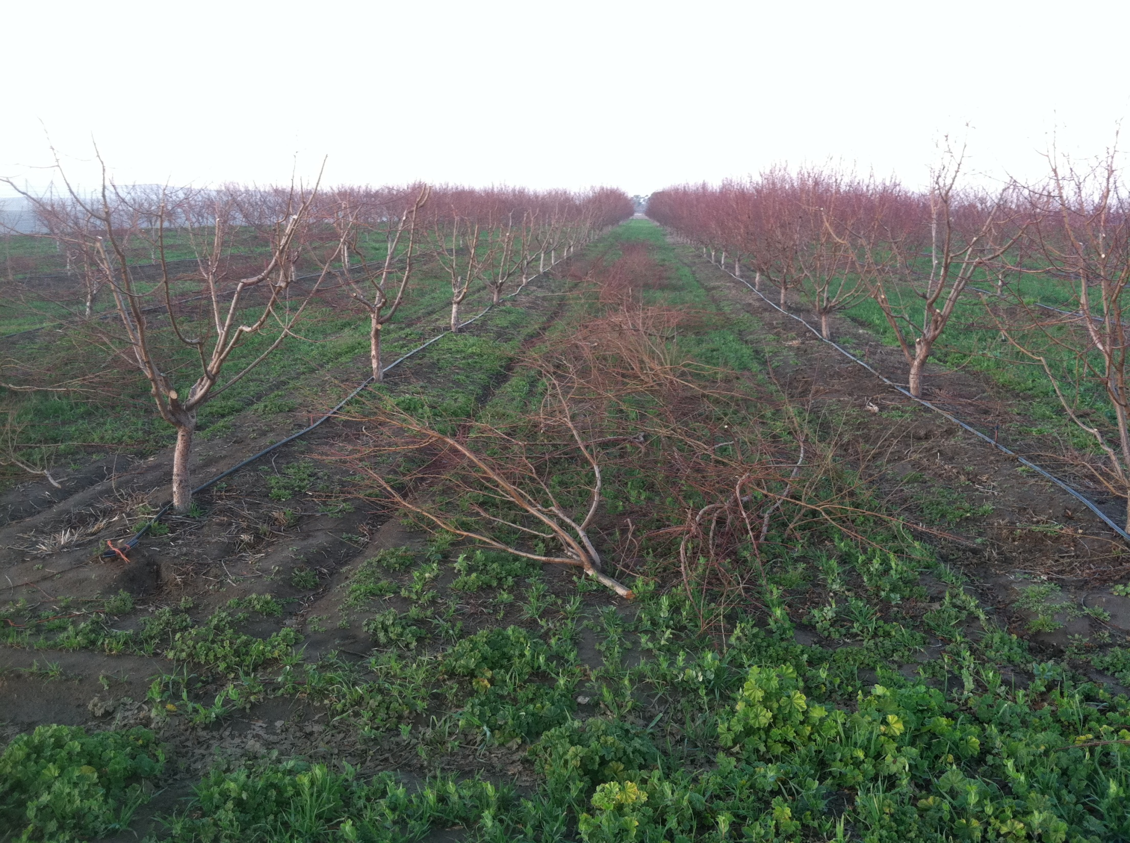
Start small & improve your production skills
Photo: Marisa Alcorta
Notes:
This is a picture of the 4 acres of stone-fruit trees on my farm in California. We leased over 600 trees which were in their second year of production.

Slide 31
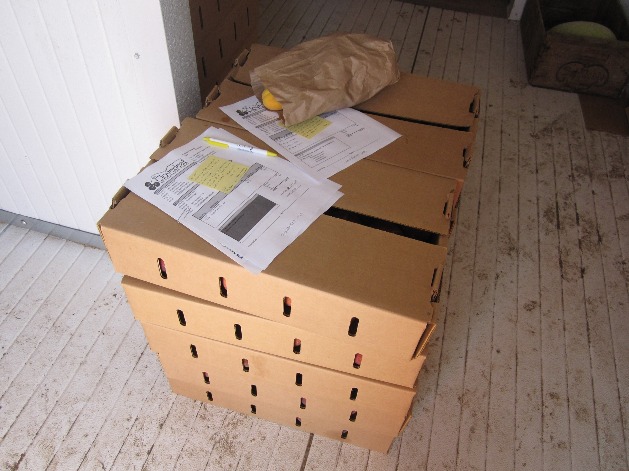
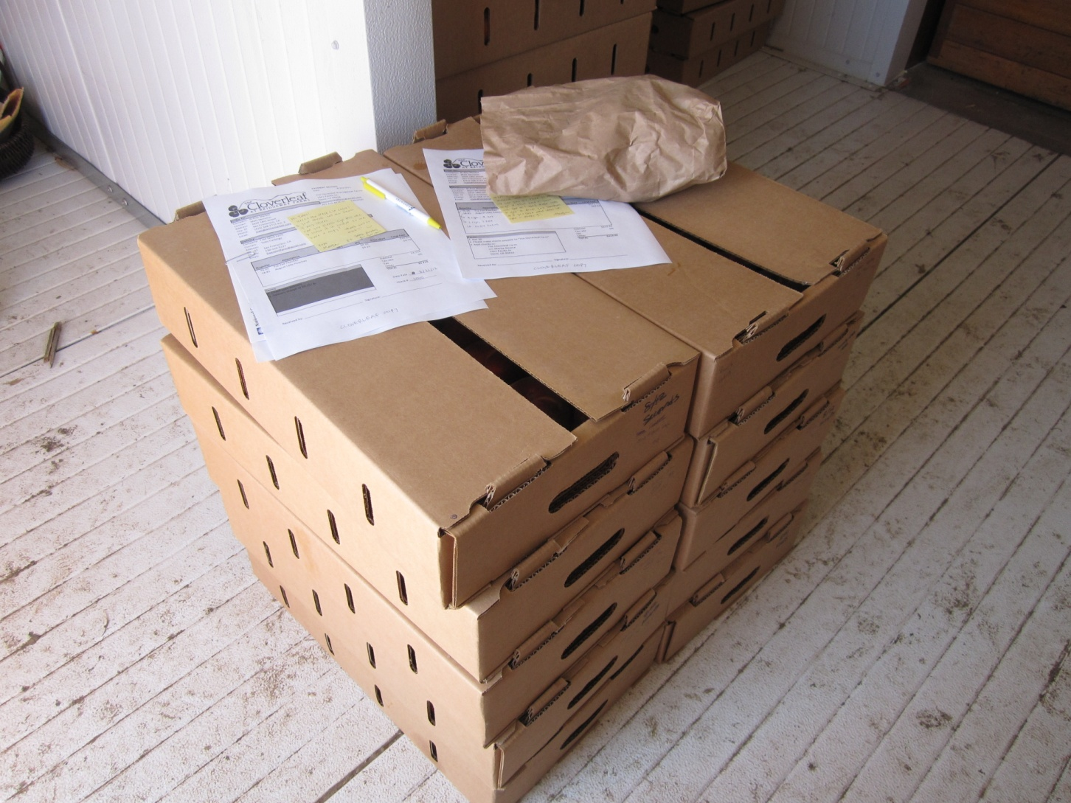
Photo: Marisa Alcorta
Notes:
We started sending small samples of our apricots, peaches, nectarines and figs to a small grocery store in the Bay Area. They loved our story and our fruit, and gave us important feedback about ripeness and how firm or soft to harvest the fruit for their store shelves. Then they began ordering larger quantities.

Slide 32
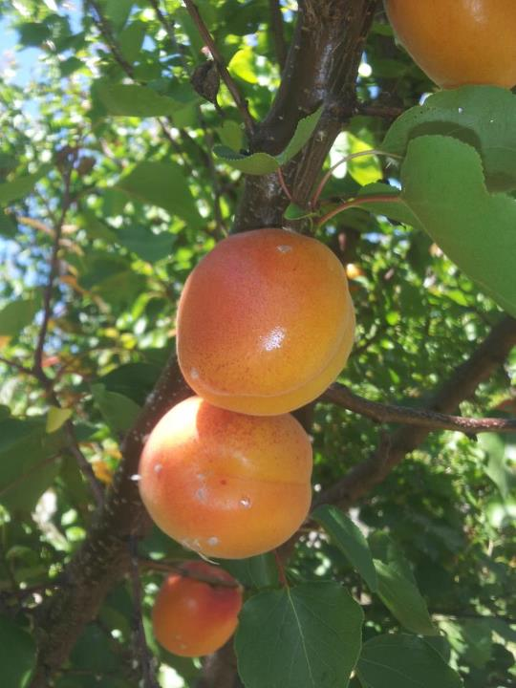
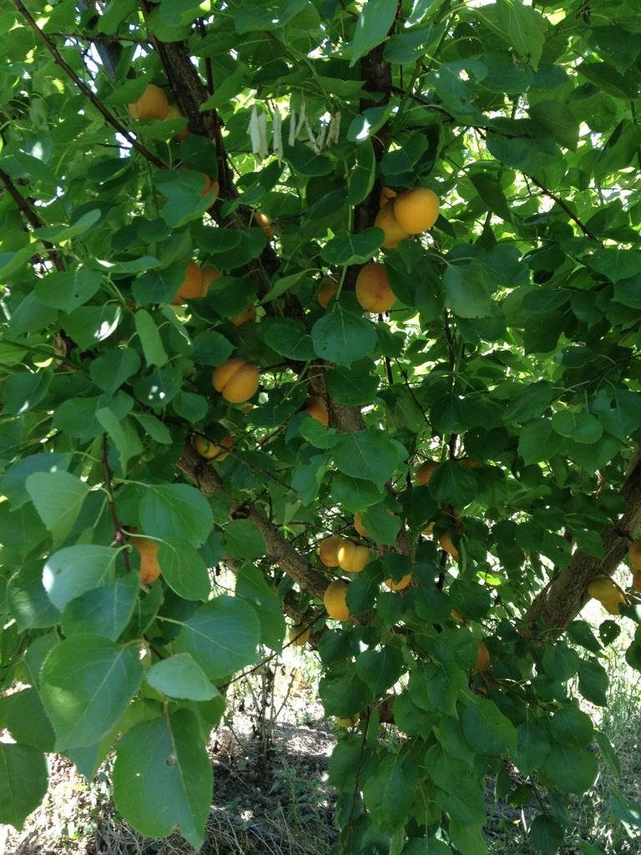
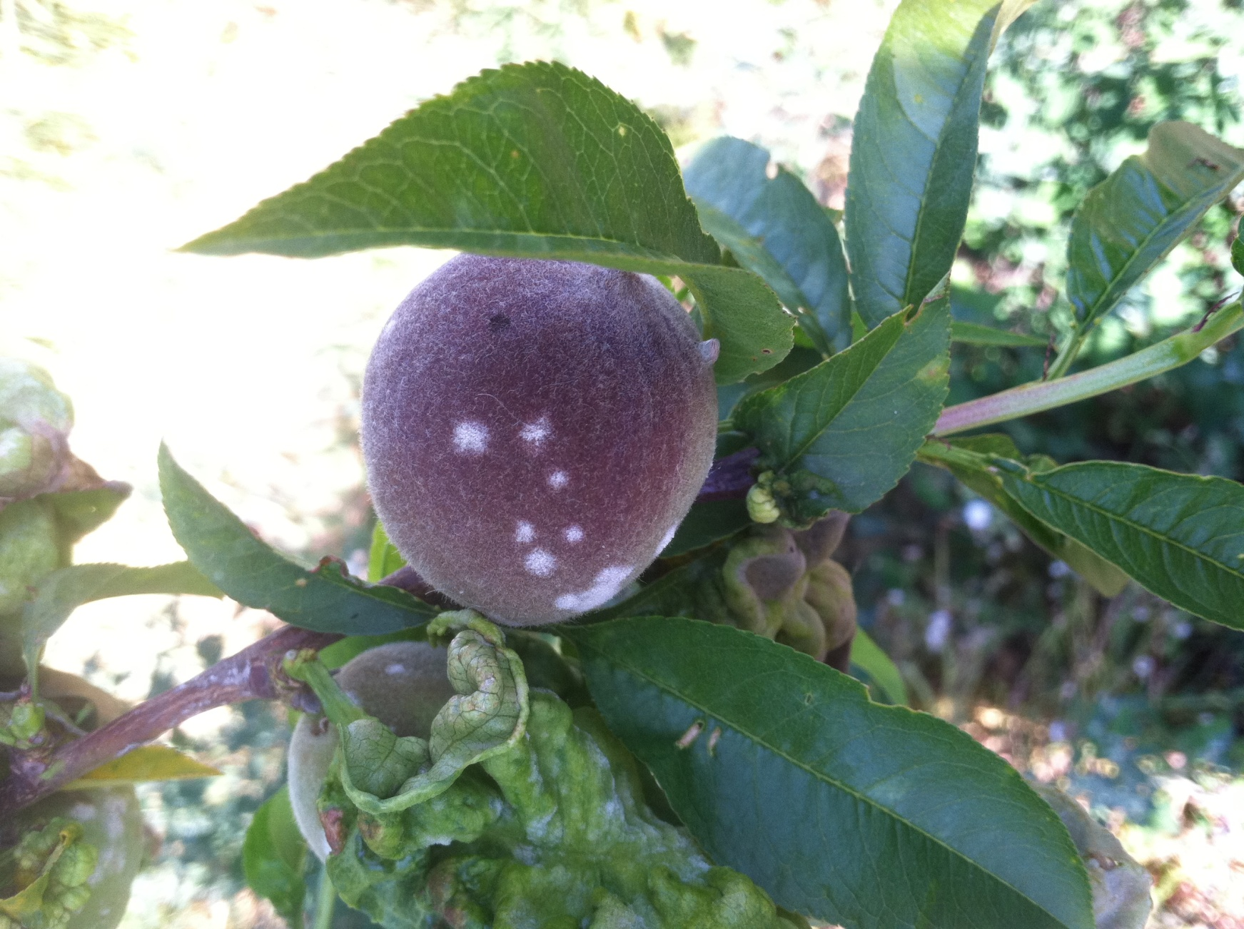
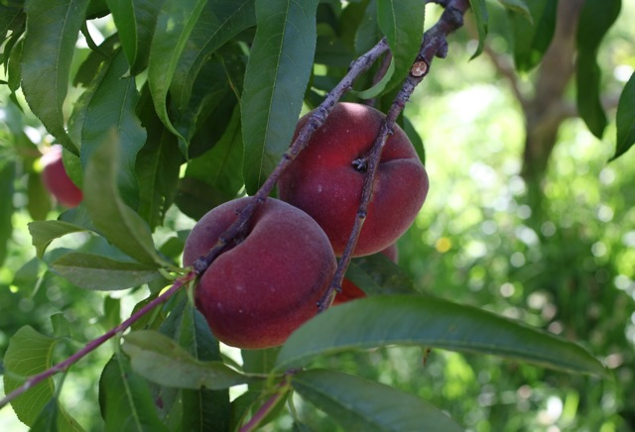
Photos: The Cloverleaf, CA
Notes:
Since it was our first year managing the orchard, we were hesitant about spraying our fruit and consequently, a fair amount of our fruit crop had blemishes on the skin. This is a picture of leaf curl and powdery mildew on our peaches. But we were able to keep the quality high for the grocery store by sorting and harvesting selectively, which although took time, paid off with a good market and a good reputation. Next year, we plan to improve our disease control so that we get more volume of the high quality fruit. But the point is that now that we’ve established a good relationship with this grocery store. As we improve our production skills and get higher yields from our orchard, we know that we can sell it to this market in the future.

Slide 33
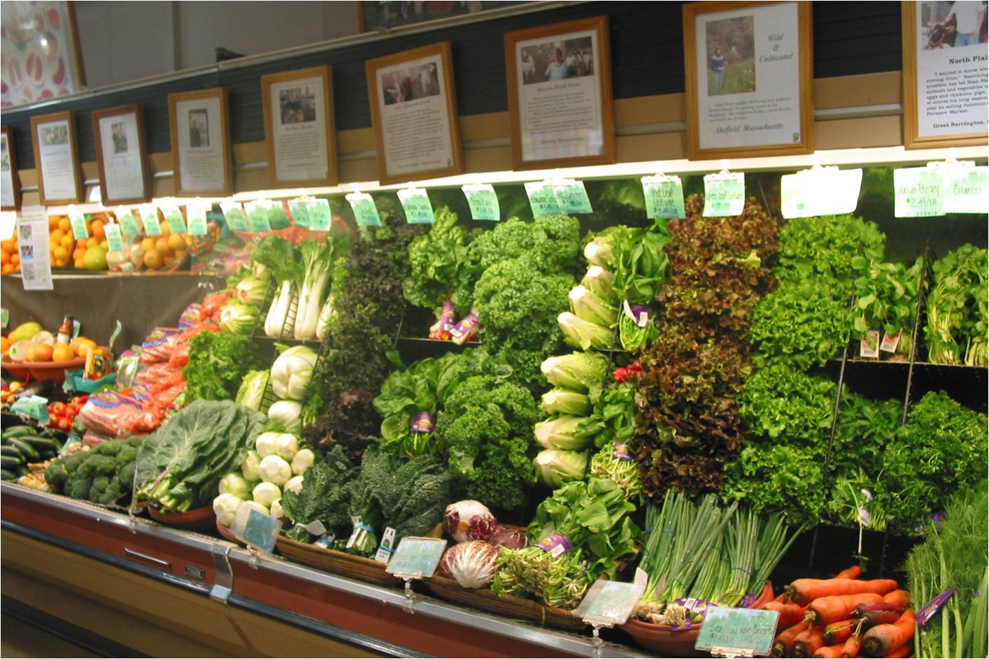
Diversification is important
Notes:
Another important risk management strategy many small farmers use is diversification. To diversify your crops means to produce a variety of products in order to spread the risk in case one of them fails. This same principle holds true for selling your products as well. For example, on our small farm, we sell our crops through a CSA, a roadside stand, as well as a grocery store. Just as it is important to diversify your crops in sustainable farming, it is equally important to diversify your markets.

Slide 34
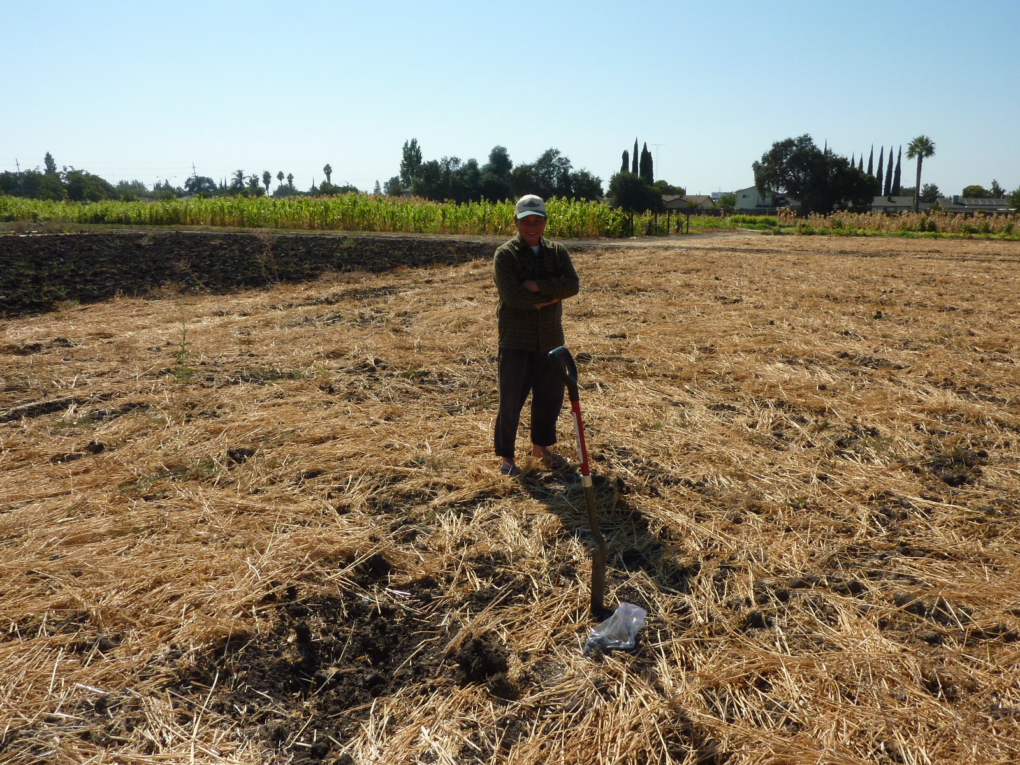
How do your goals, resources and location influence how you will sell your products?
Look back at your goals and resources worksheets from Lesson 1
Photo: Rex Dufour
Notes:
That leads us to the last basic marketing concept, which is aligning how you sell with how you farm. Let’s talk about where to start when thinking about markets. You’ve spent time thinking about how your goals, skills and resources are going to shape the kind of farm you have, so don’t throw them out the window when it comes to your marketing strategies.
The first question to ask yourself is how do your goals, skills, resources, and location influence how you will sell your products? Luckily, you already wrote down some goals and skills back in Lesson 1, and you also listed out your resources. Let’s take a look at them. Get those worksheets out so you can see what you wrote.
Why is this important? Well, for example:
If your location is pretty isolated, you’ll also need to think about what it will cost both in time and money to drive to different markets frequently, or if it might make more sense to focus on a small number of crops or products and produce a high volume to sell through a distributor or another wholesale channel.

Slide 35
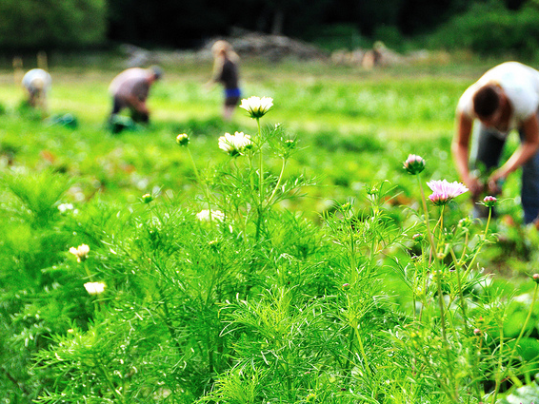
How do your goals, location, and resources influence how you will sell your products?
How will different types of markets impact your time?
Do you have the people skills to sell directly to customers?
What are your financial & labor resources?
How distant are these markets and what will it cost to get there?
Which of these markets will help you meet your financial goals?
Can you produce enough for your markets?
Photo: Langwater Farm, MA
Notes:
Now that you have reviewed those worksheets from Lesson 1, keep those goals and resources in mind as you learn about the different ways to sell your produce and ask yourself the following questions:
-How will different types of markets impact your time, both on the farm and your free time?
-Do you have the people skills, interest and patience to sell directly to customers?
-What are your financial resources, and how much labor do you have available?
-How far away from these markets are you and how much time and money will it cost to get there?
-What are your financial goals, and what kind of markets will help you meet them?
-What is the size of your farm, and how much do you want to produce? Some markets need a large amount of produce to even consider buying from you.
This list of questions is repeated on the Marketing Plan worksheet that’s meant to help you outline your marketing plan. You’ll hear more about it in Part II. But the message here is that you want to make sure your potential market choices line up with your goals, financial resources, location, and lifestyle. Remember to keep these questions in mind as you learn about the different marketing channels in Part II.

Slide 36
Summary of Basic Marketing Concepts
Doing market research
Thinking about customer values or “niche” markets
Ways to help customers remember you
Risk management strategies
Aligning your markets and your goals
Photo: Victor Bareng
Notes:
That concludes Part I of the Marketing Lesson, which covered Basic Marketing Concepts. Here’s a quick review of what we learned:

Slide 37
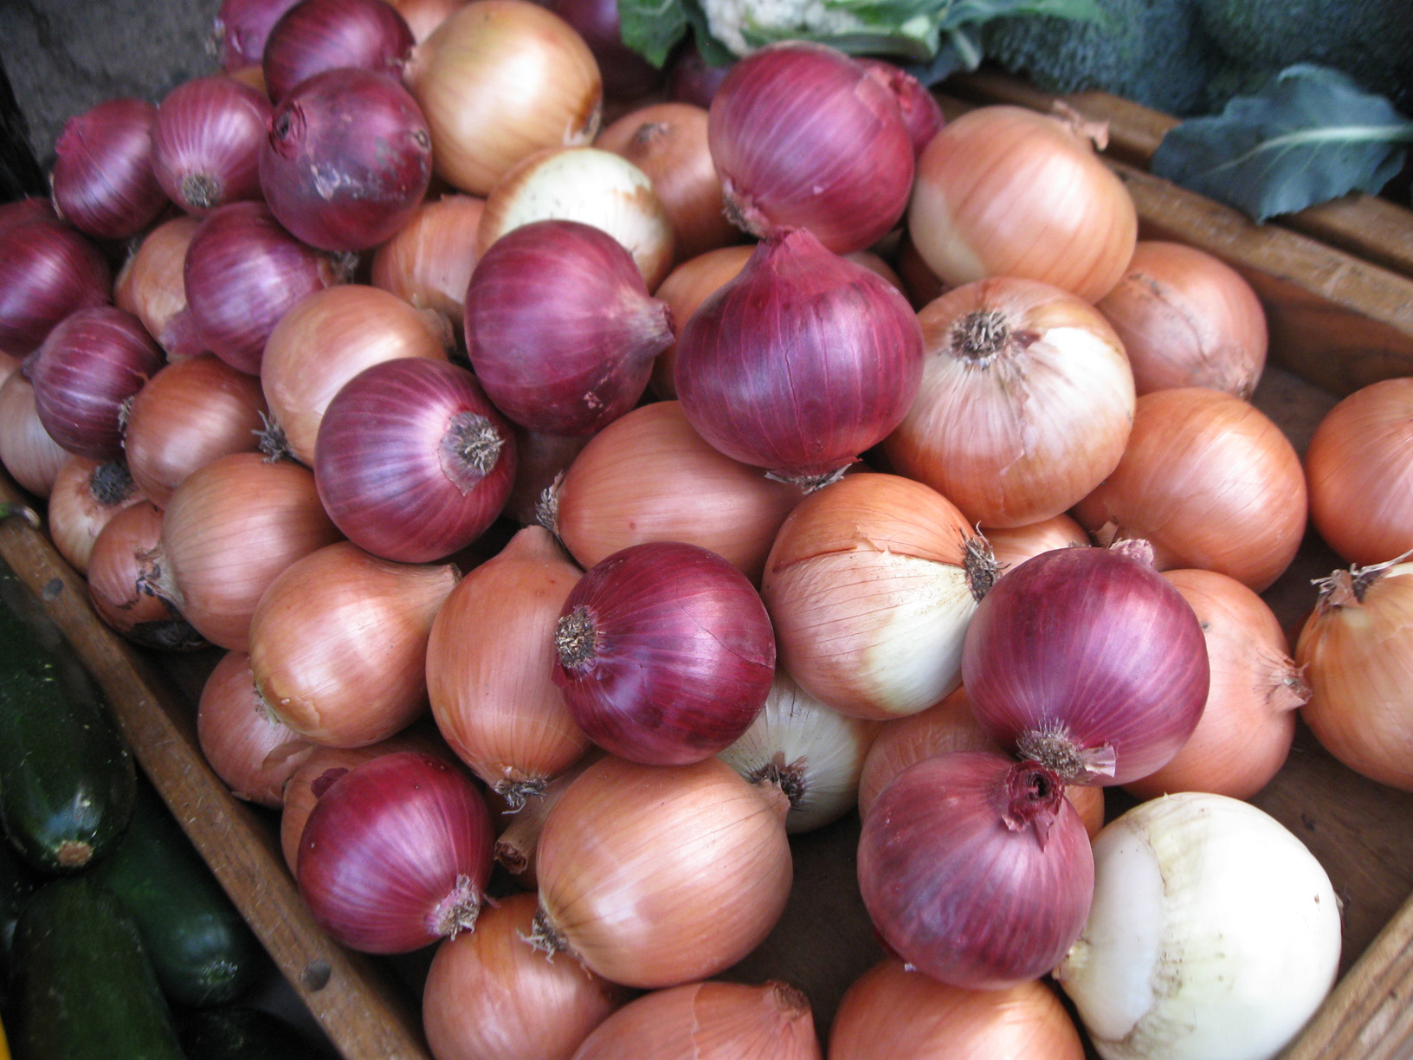
Marketing: Part II
Different ways to sell your products!
Photo: http://www.broadripplefarmersmarket.org/category/photos/
Notes:
Coming up Next is Part II of the Marketing Lesson, where we will start exploring different ways to sell your products. Thanks for listening!

