Slide 1
Pastured Meatbirds: Breeds & Nutrition
Funding for this presentation was provided by USDA's Outreach and Assistance to Socially Disadvantaged Farmers and Ranchers (OASDFR) program (Project number 2009-00705), part of the National Institute of Food and Agriculture, and Risk Management Agency (Award # 11-IE-53102-037)

Slide 2
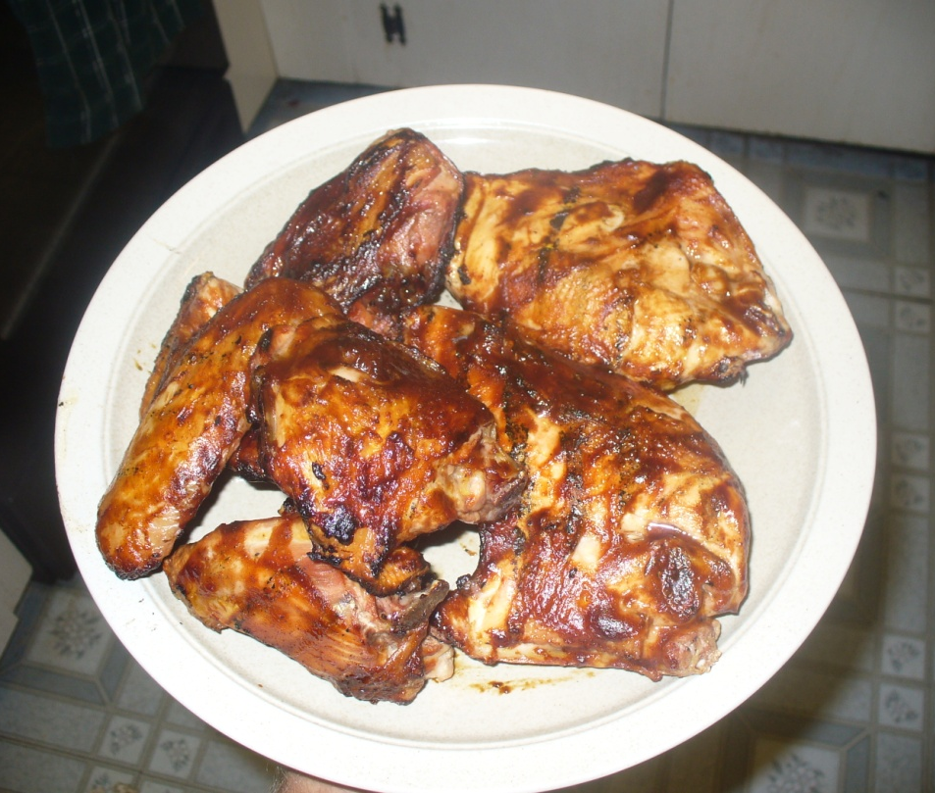
Ideal Pasture Broiler Characteristics
Good Feed Conversion
3-4:1 vs. 6-10+:1
Strong Foraging Instincts
Short Grow-out
8-9 wks (average)
Hardy on Pasture
Well Feathered
Energetic
Marketable Carcass
Good Breast Ratio
Clean Feathered (no staining)

Slide 3
Breed Selection
Cornish Cross (CX)
Label Rouge Genetics

Slide 4
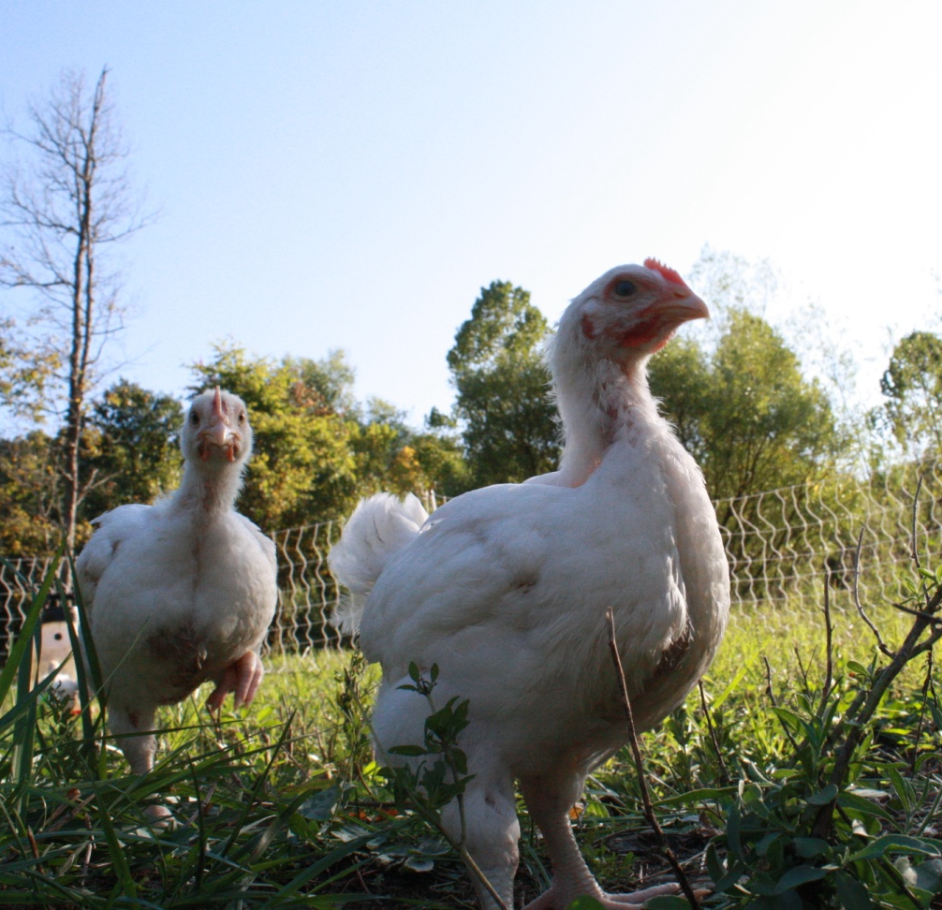
Cornish Cross
I’m 4 weeks old!
Global Standard
Very Efficient
3:1 on Pasture
Feed Conversion = $$$
Readily Available
Most common breed
4.5lbs carcass @ 8 wks
Variety very important
Cobb 506, Ross 700, etc

Slide 5
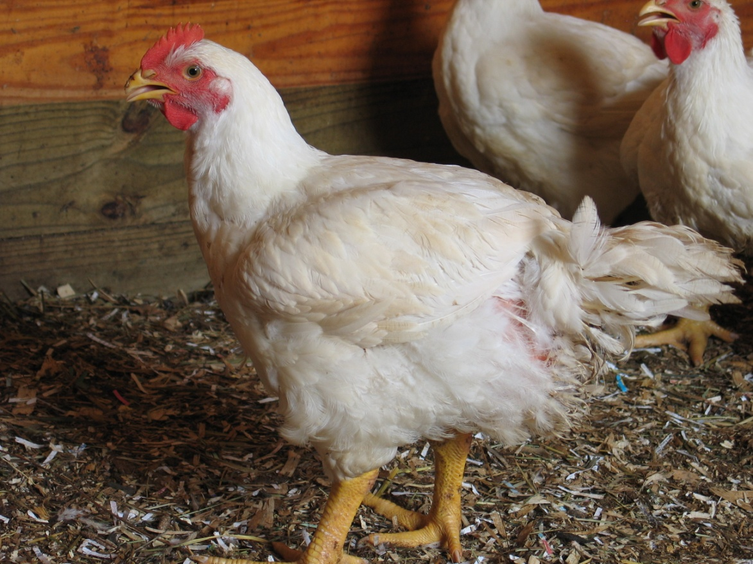
Cornish Cross Considerations
Not the “Ideal” breed for pasture
Bred for Controlled environments
Older varieties are best
Cobb 500 or Ross 308
Still retain foraging instincts
Familiar & Breastmeat
Need a Balanced Ration
Avoid Leg/Heart Problems
High Heat is Deadly (esp. w/ humidity)

Slide 6
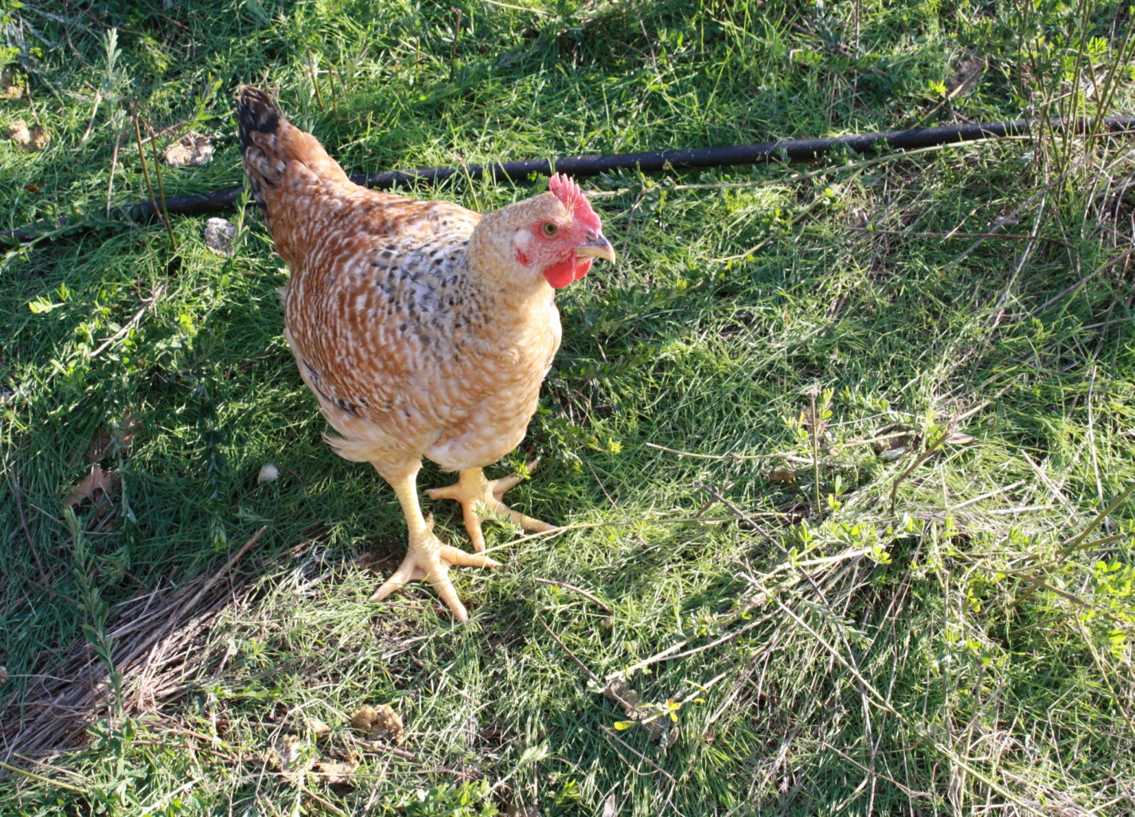
Label Rouge Genetics
Originated w/ French Free-Range Program
Different Lines
Freedom/Red Rangers
Rosambros & Others
Slower Grow Out
4-5 lbs @ 9-11 wks
High Feed Conversion
Designed for Pasture
Fewer Health problems
Good Forager/Marketing

Slide 7
Meatbird Nutrition
Broilers have specific feed needs
High Protein (Methionine)
Higher as chicks, lower at end
22 - 19% Protein
Most food comes from feed
Pasture = 0 – 20 % of ration
Poultry aren’t ruminants!
Need supplemental feed

Slide 8
Inexpensive Homemade Feeder

Slide 9
Feeding
Poultry Eating = Meat
Feed Conversion Important
Can’t starve birds into profitability
Lots of feeder space
4 in/bird if straight, less if round
Weather affects amount eaten
More in Cold = warmth
Won’t eat in heat = less growth and profits
Leg Problems = Feed Problem

Slide 10
Example – Cutting Profits by Cutting Feed
Flock eats 400 lbs/wk ($.25/lb) - $100/wk
3:1 FCR, whole birds sells for $3.75/lb
400 lbs feed = 130 lbs chicken = 100 lbs meat
100 lbs meat = $375
Restrict feed ¼ = 300 lbs feed/wk = $75 in feed
100 lbs chicken = 75 lbs meat = $280 meat
Saving $25 dollars in feed cost you $100 profit!

Slide 11
Feed Storage
Feed Storage
Must be kept dry
Rodents
Salmonella
Feed goes bad/stale
Moisture & heat
Age
Buying Bulk = Cheaper Price
Delivery
Can purchase used feed bins
Can store in barrels in field

Slide 13
Resources
Organizations
ATTRA – the National Sustainable Agriculture Information Service – http://www.attra.org
American Pastured Poultry Producers Association (APPPA) http://www.apppa.org/
Magazines
GRIT! – APPPA Magazine
ATTRA Publications
Pastured Poultry Nutrition
Meat Chicken Breeds for Pastured Production
Books
APPPA. 2006. Raising Poultry on Pasture – Ten Years of Success. 246 p.

