Slide 1
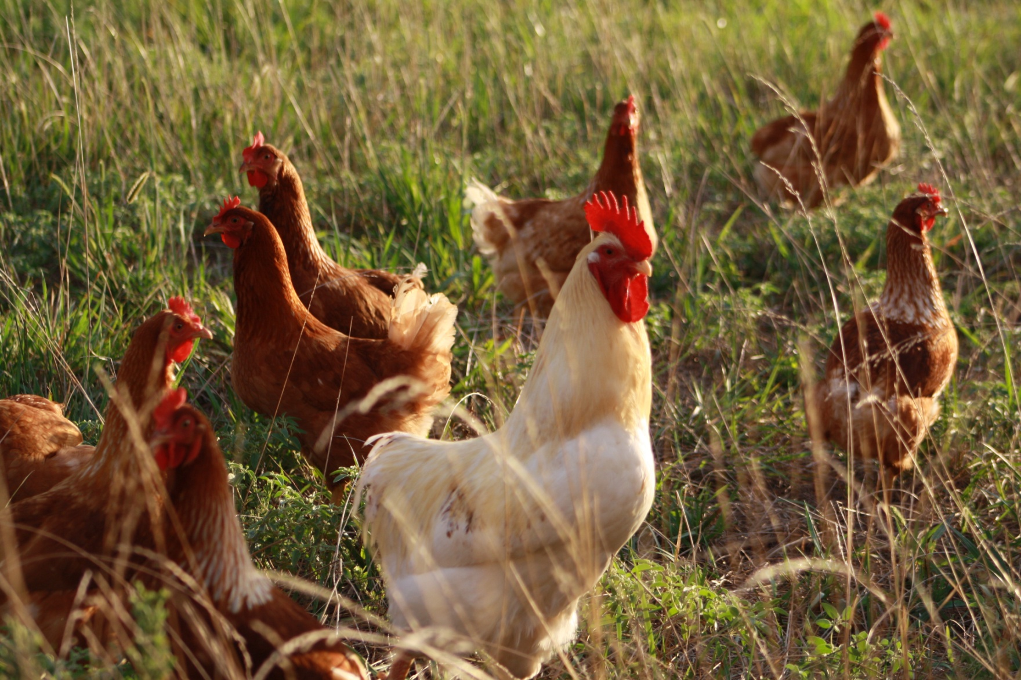



Pastured Egg Production
Funding for this presentation was provided by USDA's Outreach and Assistance to Socially Disadvantaged Farmers and Ranchers (OASDFR) program (Project number 2009-00705), part of the National Institute of Food and Agriculture, and Risk Management Agency (Award # 11-IE-53102-037)

Slide 2
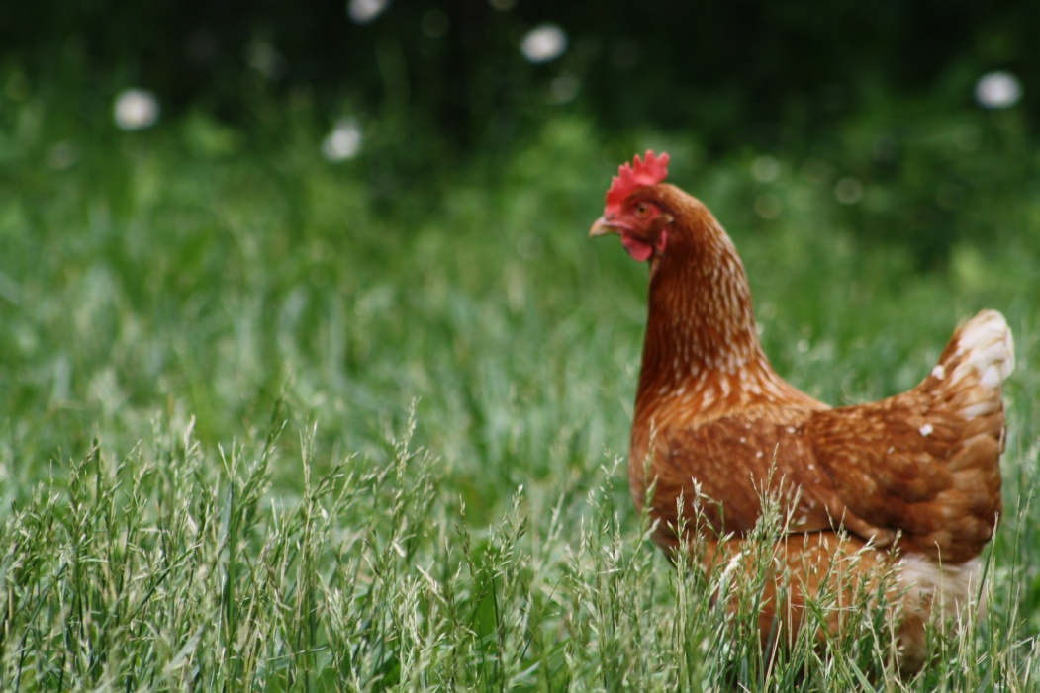
What is Pastured Poultry?
Raised outdoors on grass
Birds express instincts
Seasonal production
Birds balance diet
  Insects
  Plants
Pastured vs free range?
Challenges and Benefits to Confinement

Slide 3
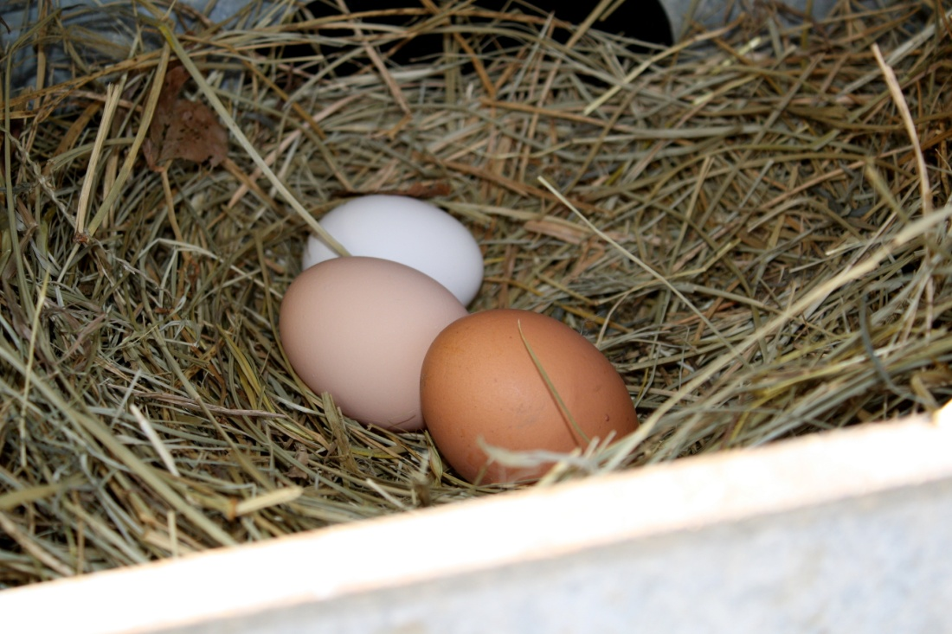
Why Pastured Hens & Eggs?
Easy In, Easy Out
  Eggs in 5 months
  Gateway livestock
Smaller Size
  Hen vs cow
  Infrastructure
Premium Eggs/Price
  Quality, flavor, nutrition
  Cultural Appreciation
  Higher Price/dz
Fertility on pasture
Steady cash flow

Slide 4
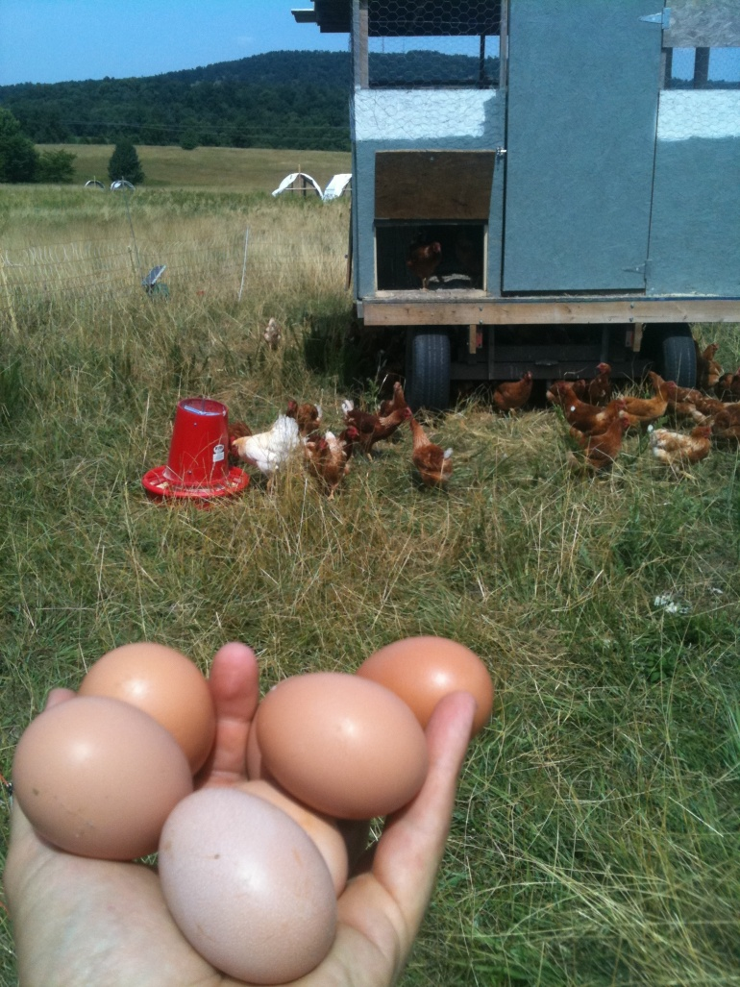
So How’s It Done?
Laying chicks ordered
  Brooded inside
Placed out on pasture
  Trained to housing
Laying at 5-6 months
  Breed & Pullet eggs
  Point of lay = ~ 25 lbs
Eggs collected daily
Birds Processed around 2 yrs
  Decreased laying rate
  At state or USDA processor
  Some states process on farm

Slide 5
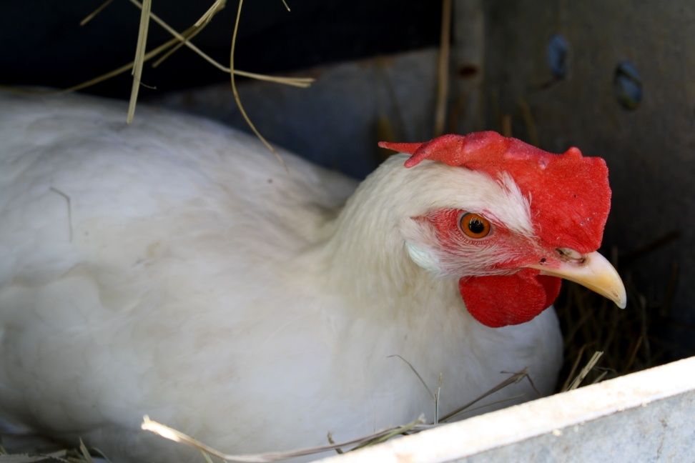
Layer Breeds
Breed is extremely important
    30 – 300+ eggs/hen
    Same input costs
Egg Color
  Brown Eggs
    Sex-Links, RI Reds, etc
  White Eggs
    Production Leghorns, CA Whites
All layer breeds forage well
Avoid De-beaked, de-clawed, or dubbed birds

Slide 6
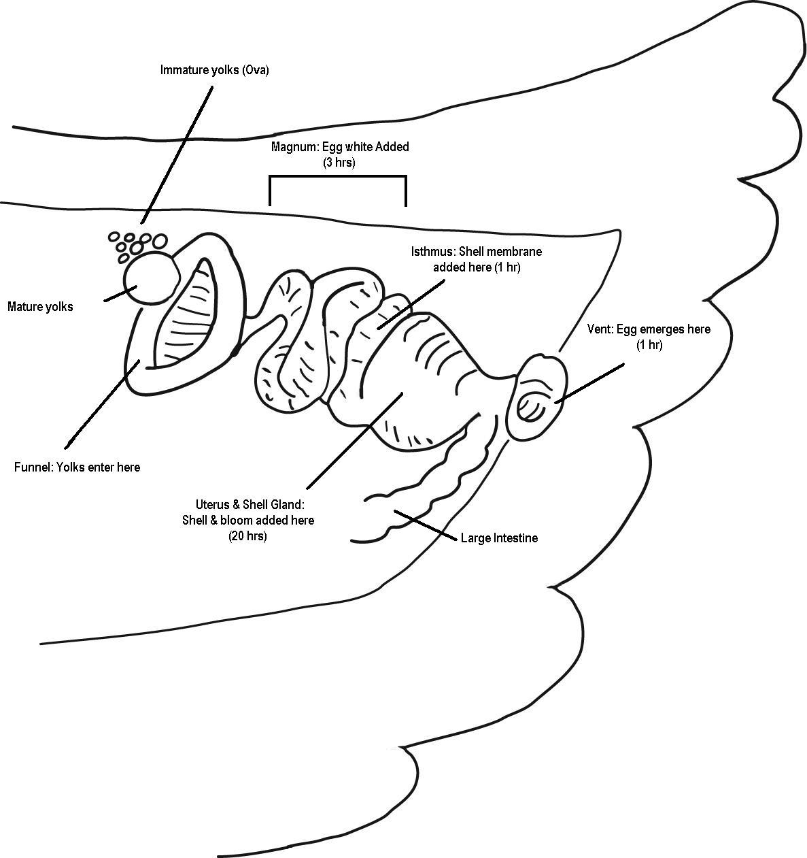
The Laying of an Egg
Around 5-6 months
One egg ~25 hrs
Egg Formation
  Released from ovary
  White & membrane
  Shell & Bloom
  Rotates, out the vent
Hen seeks dark, quiet
Response to light/seasonality

Slide 7
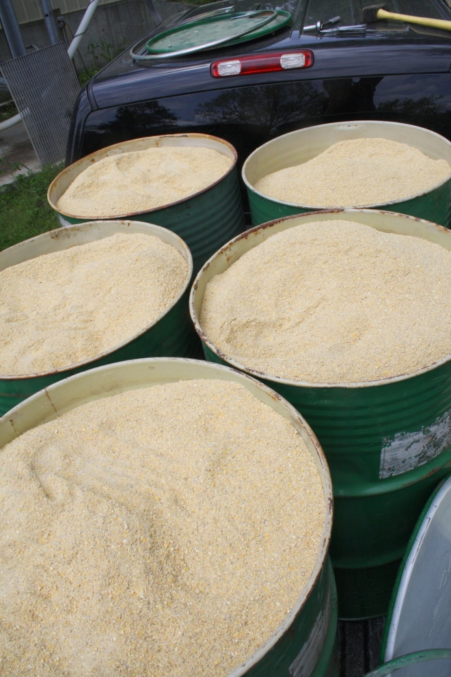
Layer Nutrition
Layers = Great Foragers
Calcium
  Too little
    Thin Eggshells
    Osteoporosis
  Too much
    >2.5% Ca during grow out
Protein Needs
  Pullet Growth
  Molting

Slide 8
Egg Handling
Preserve Quality & Safety
  Can loose one grade/day
  Salmonella
Wash Carefully
Collected Often
  Daily
  Twice/day in heat

Slide 9
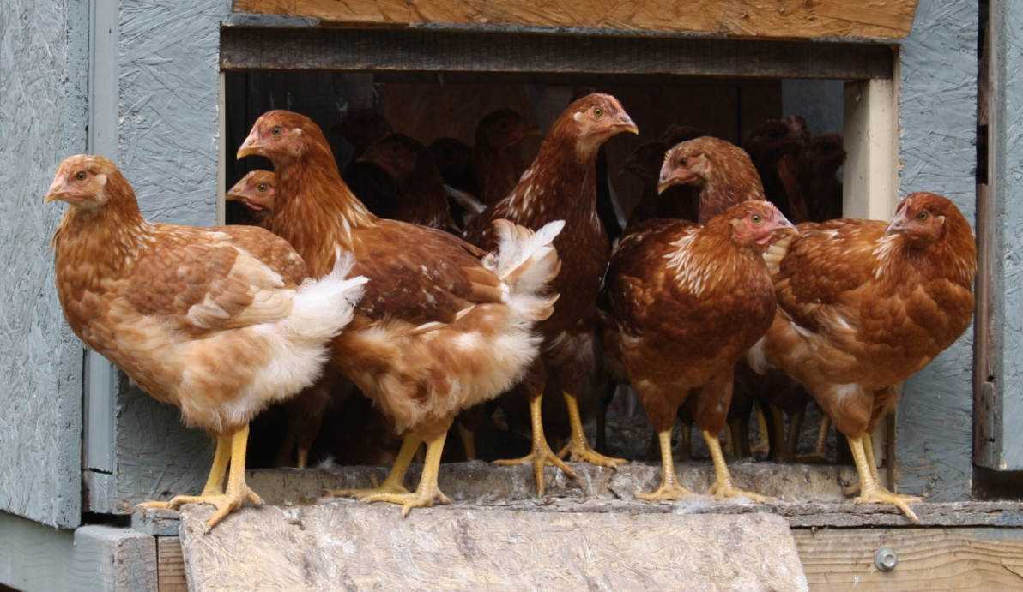
Layer Housing
Basic needs
  Shelter from elements
    Wind & Rain
    Sun & Predators
    Ventilation
Roosting
Laying Boxes
Often Moveable
Ideally low cost

Slide 10
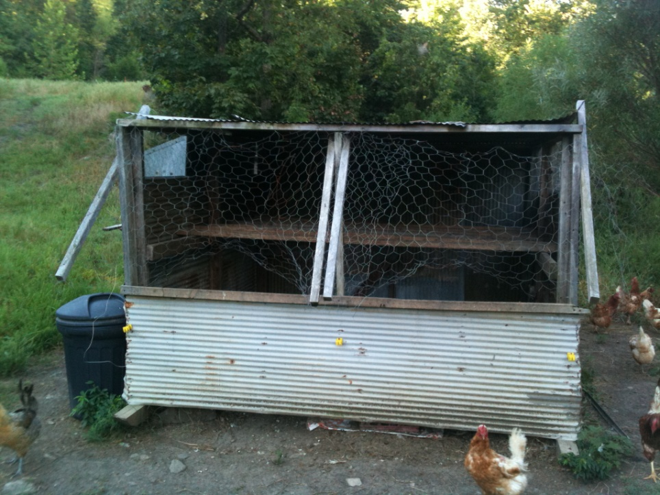
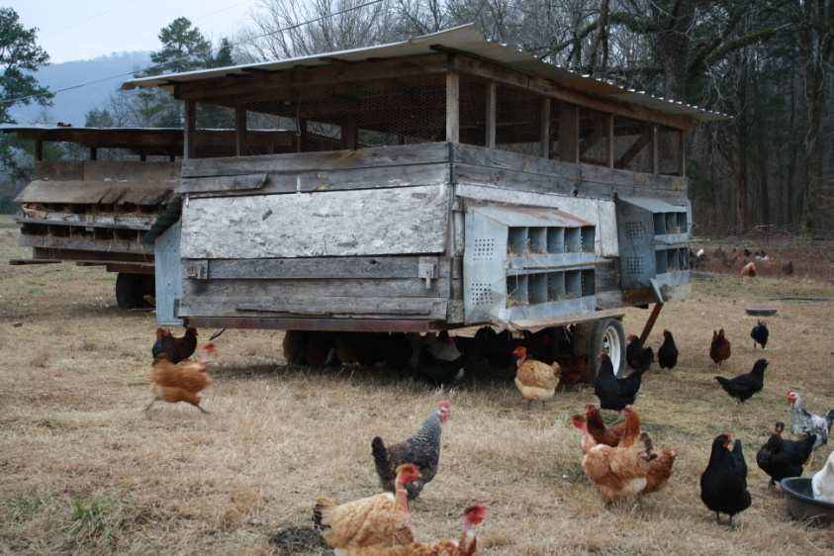
Housing Styles
Mobile “Eggmobile” Type Coop
Colony House on Skids

Slide 11
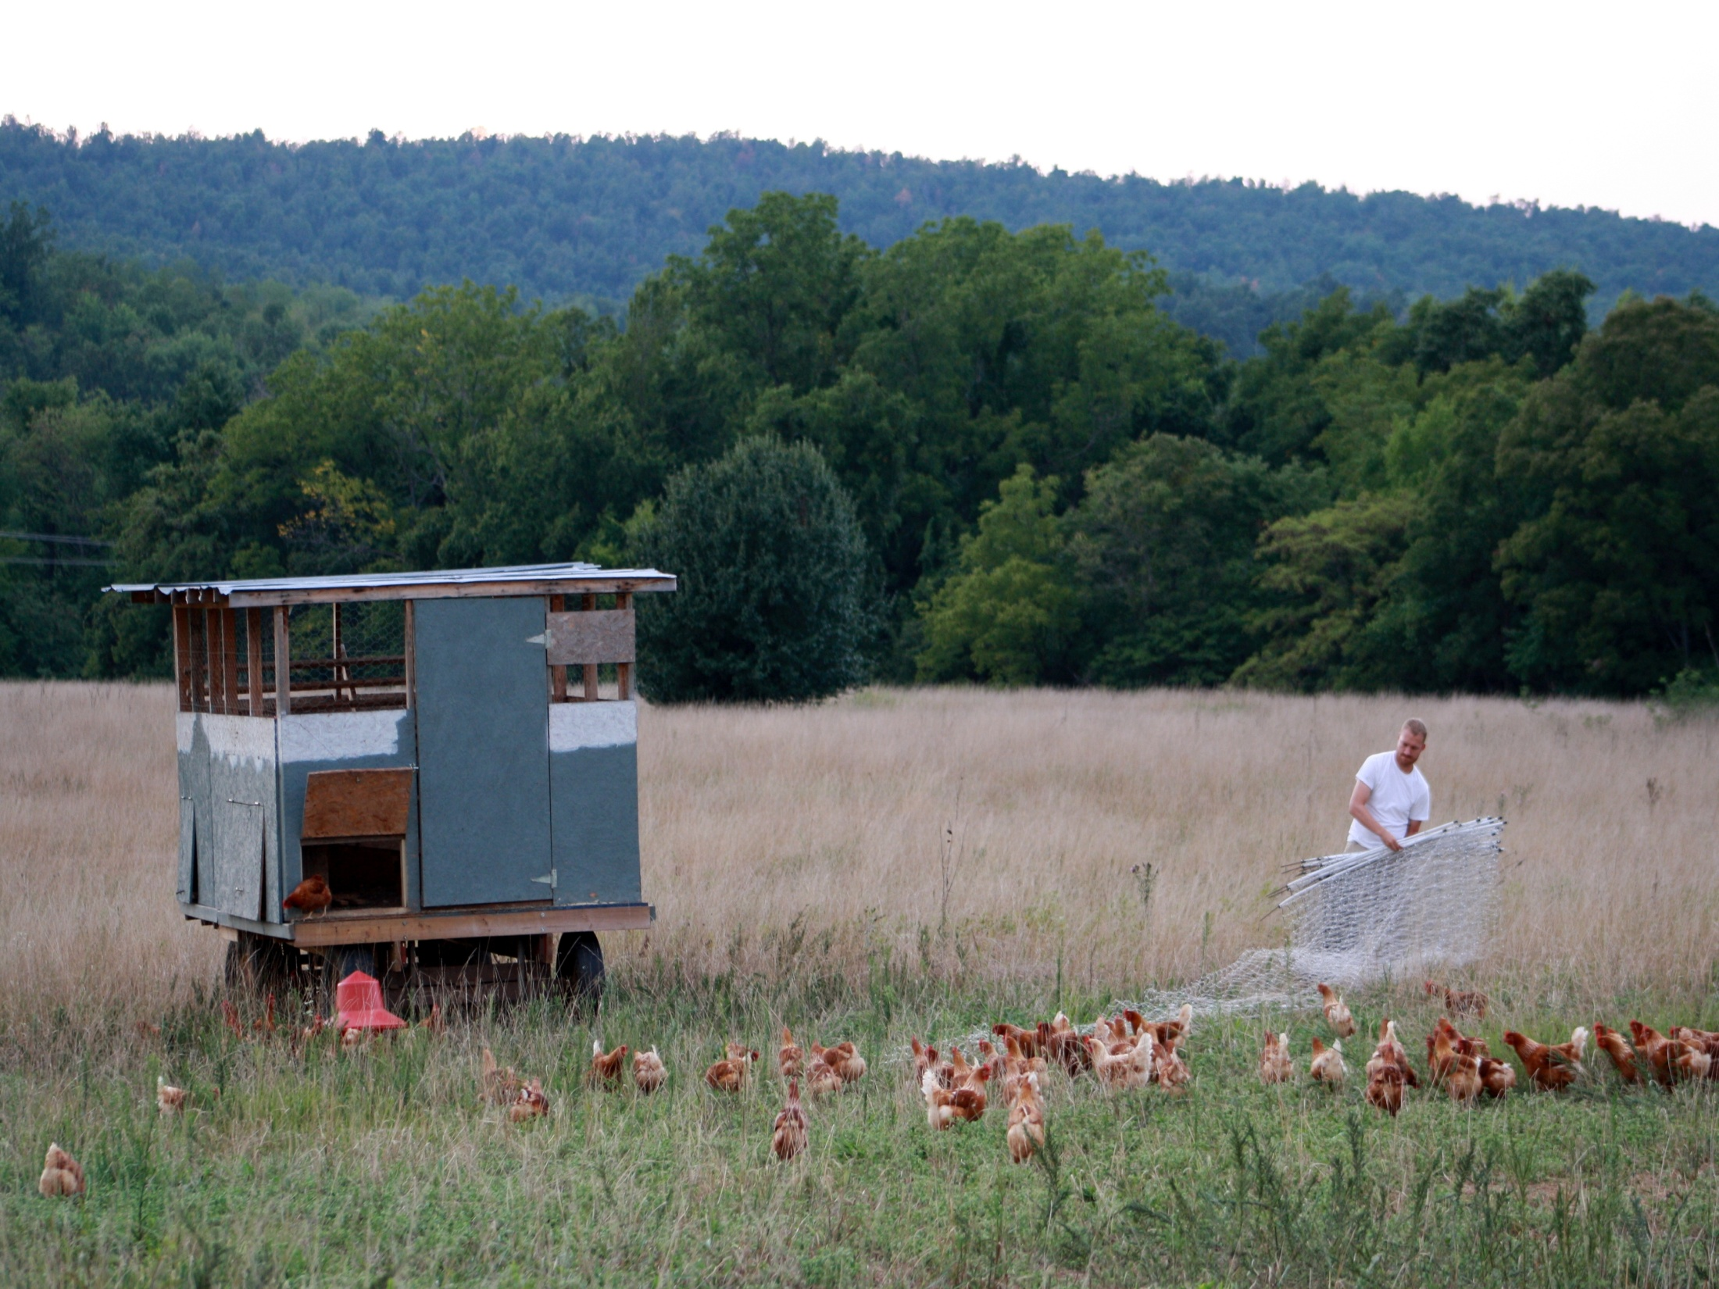
Egg Mobiles

Slide 12
Making Money
No Records = No Profits
Key Factors
  % Lay Rate
  Feed Conversion
  Know Production Cost!
Consistent Egg Supply
  Multiple Flocks
  Maximize Egg Production
Culling/Pullet $
Whole Farm Impact

Slide 13
Resources
Organizations
  ATTRA – the National Sustainable Agriculture Information Service – http://www.attra.org
  American Pastured Poultry Producers Association (APPPA) http://www.apppa.org/
ATTRA Publications
  Small Scale Egg Handling
  Pastured Poultry Nutrition
  Range Poultry Housing
  Small Scale Poultry Processing

Slide 14
Resources
Magazines
  GRIT! – APPPA Trade Magazine
Online Resources
  Chicken Assement for Increasing Productity
    Chapter 2: Selecting for Egg Production Available at http://albc-usa.org/EducationalResources/chickens.html
Books
  APPPA. 2006. Raising Poultry on Pasture – Ten Years of Success. 246 p.
  Salatin, Joel. 1996. Pastured Poultry Profit$. 371 p.
  Damerow, Gail. 2011. Storey’s Guide to Raising Chickens. 356 p.

